Slide 1



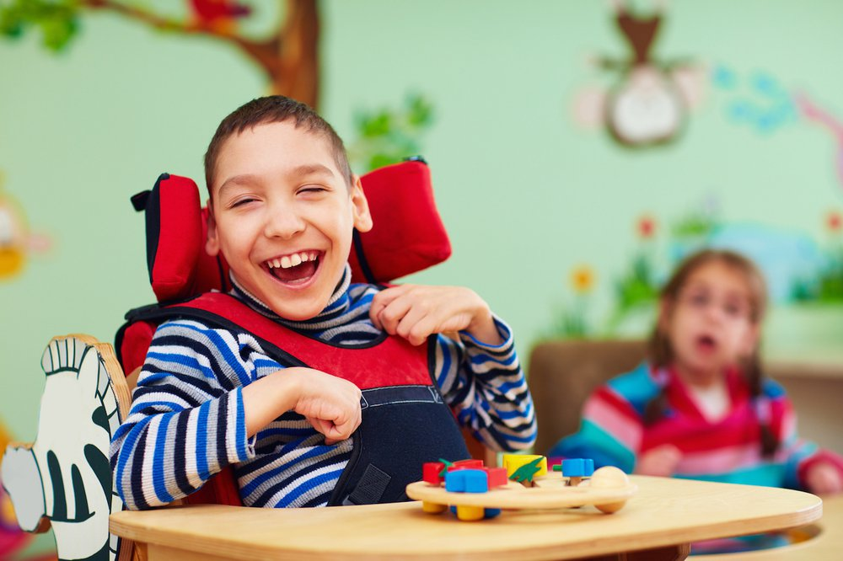
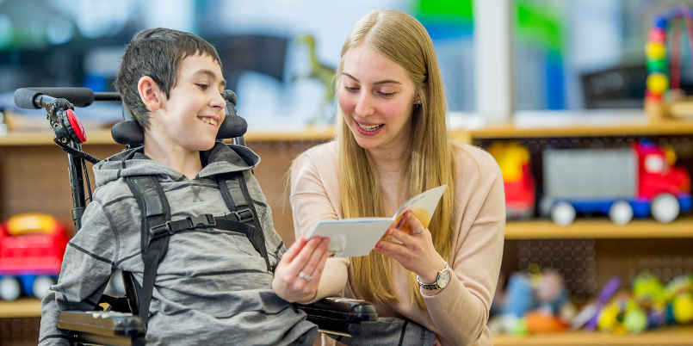

Resetting our Plan for Education and Learning
Notes:
The resetting of the Education and Learning Plan is based on the premise that we have many strategies in Luton as well as national initiatives with an impact on education and learning but that they are not currently ‘joined up’ or with a clear pathway or roadmap for schools and learning providers to know what is expected of them.
Now is the right time to recalibrate what we have, what is important to achieve, and to plan (in simple terms) how we plan to get there and what it looks like when we do.

Slide 2
‘Our town-wide vision for Luton 2040 is to be a healthy, fair and sustainable town where everyone can thrive and no-one has to live in poverty’
Luton 2040
Inclusive Economy
Population Wellbeing
Tackling Climate Emergency
Child Friendly Town
Strong Communities
Learning & Education Strategy
Pathway of Learning covering Early Years, Schools, Post 16 and transition to Adulthood
Inclusion and meeting the needs and ambitions of every child (SP4)
Integrated Education, Children’s Social Care and Health (SP6)
Sport & Physical Activity Strategy 2023
Safeguarding Partnership
Active Luton Strategy: Creating opportunities to thrive 2023
Luton’s All Age Mental Health Strategy 2024
SEND Transformation
Luton Employment & Skills Strategy 2022
Family Hubs roll out
Fairness Strategy: A Town built on fairness and Justice 2023
Joint SEN & Disabilities Strategy 2022
Childcare Expansion
Harnessing Momentum: Strategy for Arts & Culture
Behaviour, Inclusion and Wellbeing Strategy
Manifesto Pledges
Luton Education Strategy for Children & Young People 2019
Population and Wellbeing Strategy 2023
Library Strategy 2020
Notes:
We have many, many strategies in Luton and schools are unclear on what is expected of them in implementing these strategies. Many are overarching principles of what we want to achieve but without the plan to achieve our aims step by step.
Most of these strategies have bene created in isolation from each other and all make demands on our schools without thinking of these demands in the context of everyone’s else’s demands.
Our Luton 2040 Vision provides us with a clear community wide ambition and goal. Education and Learning is featured in all of the five key themes. However, 2040 is a long way away and schools and learning providers need to understand the manageable steps they can make towards achieving these ambitions in bite sized pieces so that we can see tangible changes and movement towards achieving these goals.
In trying to bridge the gulf between the 2040 ambitions and the multiple strategies we have, a clear Education and Learning Reset Plan is key in focusing the attention of our schools, learning providers and also Council teams and departments to ensure that we all join up and overcome the silo structures and ways of working which currently exist.

Slide 3
Four Key Themes
Academic and Learning Provision
Mental Health and Wellbeing
Special Educational Needs
Confidence, Ambition and Pathways to Employment
Notes:
In pulling together the many strategies and initiatives we have to implement to transform outcomes, we have captured 4 Key Themes within which we aim to focus the efforts of our schools and learning providers in moving towards achieving Luton 2040 Vision and outcomes.
Academic and Learning Provision is all about the provision and inputs in schools and learning providers to improve outcomes
Special Educational Needs is all about our provision and outcomes for those with SEND
Mental Health and Wellbeing is all about the safety and mental health of our children and staff to create the culture and ethos upon which our provision can move children forward.
The confidence, ambition and pathways to employment is all about our children and young people, their views and skills, and their perceptions and confidence

Slide 4
Academic and Learning Provision
Mental Health and Wellbeing
SEND
Confidence, Ambition and Pathways
2029-30
2028-29
2027-28
Review and Reset
Academic and Learning Provision
Mental Health and Wellbeing
SEND
Confidence, Ambition and Pathways
2026-27
2025-26
2024-25
What tangible different outcomes do we want and what actions by step will get us there?
Notes:
Our aim is to create a three year Detailed Plan with tangible outcomes and changes we wish to see in place by 2027, and which begin that journey from where we are now to where we wish to be in 2040. The 3 year plan will cover a plan for each of the 4 Key Themes with measurable outcomes and a systematic governance process to check progress and hold everyone, including partners, to account.
We aim then to review the plans in 2027 to then set a further 3 year plan through to 2030. This will then lead to a further 3 year plan for 2030-2033 with the aim that all the pieces of the jigsaw are then in place to meet the 2040 Vision ambitions.

Slide 5
How have we come to the key priorities in each theme?
Luton’s current performance - student performance & disparity
- exclusion and vulnerability
What young people say - School Health Education Unit (SHEU)
- The voice of young people
National and Local Priorities - SEND & AP Transformation
- DSG High Needs Block
Luton’s community ambition - Luton 2040
- Response to knife crime and safety
Notes:
Our priorities within each of the following themes are based on data and our corporate goals for children and young people. Some of the priorities have arisen out of feedback from the community and our children and young people. The Council already has a clear ambition based on the community wide Luton 2040 Vision which has encompassed the views and contributions of the wider community on what we need to do to improve the town and the opportunities for our Youth.

Slide 6
Key features
Inclusive Practice, in its widest sense, is core to much of what Luton 2040 aims to achieve
All children should belong, have a voice that is heard, and understand that they matter in what e are trying to achieve
Raising aspirations and taking action in improving pupil outcomes, achievement and progress over transitions is essential if all our young people are to achieve the skills and qualifications they need
The community’s role, the role of families, council services and schools need to join up in ways they don’t necessarily do at the moment to develop a confidence and support for learning and reducing the risk of leaving children behind
Notes:
There are key features that are core to our thinking. It is important that we see this plan not as a schools’ plan, but as a community wide plan and affecting the range of services, opportunities and people across the community of Luton in making change.

Slide 7
Academic and Learning Provision
What we wish to achieve by 2027?
Excellence for Everyone | Local Inclusion Framework, Commitment and Plan Annual School Monitoring Scorecard Focus on Reading and Key Stage 3 Reading Intervention Tackling the achievement of low performing groups
Lo
Community Heart | Strong Neighbourhood based Communities of Schools Co-ordinated services within Neighbourhood Structures Wrap-around out of school learning
Belonging and Mattering | Systematic use of children and Young People’s Voice All children, including vulnerable & EHE, feeling they belong UNICEF Children’s embedded and practised
Skills and Employability | Skill progression through transition points Increased access to Internships and apprenticeships High quality Vocational Pathways Digital literacy and digital access for all
Notes:
Within our plans around provision, Inclusion is at the heart with the mantra that every child should belong, feel that they matter, and that inequalities and gaps are addressed.
Building a consistency across the town requires strong Neighbourhoods of schools and services working together in a ‘joined up way’ to serve those neighbourhoods. Schools and Nurseries are seen as the centre of their communities but once the schools close at 4pm, opportunities for some children are reduced. We are looking to strengthen the Neighbourhood Learning Communities and also strengthen how Neighbourhoods or Schools can collectively
Share, work together and build a learning confidence.
Reading is a key skill that all young people need to achieve. For those who don’t achieve the end of Key Stage 2 expectations in reading, they are more likely to fall away when they enter secondary school and reduce their life and employment chances into adulthood.
Our schools do well in relation to the quality of education with almost all schools being Ofsted Good or Better. Some of the schools and provisions in Luton are very inclusive and go the extra mile to adapt their curriculum and organisation to meet the needs of all, no matter how challenging. The national SEND & Alternative Provision

Slide 8
SEND & Diversity of Provision
What do we wish to achieve by 2027?
Inclusion and Support at the right place and the right time | Ordinarily Available Inclusive Practice & graduated response Transparent data and funding arrangements Highly skilled workforce & resident school based specialists
Alternative and Diverse Provision | A Three Tiered Approach Multidisciplinary Taskforce and school based expert practitioners Zero exclusion of SEND due to reduced unmet need
SEMH Pathway | Co-ordinated pathway from mainstream to complex need Therapeutic thinking Outreach and co-ordinated SEMH provisions and expertise New special schools and resourced provisions
Pathways to Adulthood | Post 16 SEND Provision Strategy College offer and pathways to independence in adulthood Supported internships and apprenticeships
Notes:
SEND is a national issue and local issue on so many fronts – financially, educationally, and socially. SEND diagnosis is increasing year on year and this is a significant issue for both the Council and Health partners. Inclusion and getting provision right at the very base is crucial. If we were able to meet children’s SEND needs in our mainstream schools, the costs and demand for more expensive placements would reduce. However, for schools to be inclusive needs development and support.
Alternative Provision for those young people who are unable to be managed in our schools needs a fundamental overhaul in line with the National SEND & Alternative Provision Transformation Plan arising from the Government’s Green Paper on the future of SEND (2022).
A pathway for those children with social, emotional and mental health is currently missing in Luton with support fragmented and not joined up. The building of a new SEMH Special School is one part of a much wider strategy needed.
For young people with SEND, the current pathway beyond the age of 16 is not well planned leading to some not being well prepared for adulthood and independence along with employment. .

Slide 9
Mental Health and Wellbeing
What do we wish to achieve by 2027?
Mental and emotional health | Town wide mental health and wellbeing support at universal and targeted levels Staff and Headteacher wellbeing and resilience Mental health practitioner and expert responder capacity
Safety and safe from exploitation | Safe out of school spaces to enhance learning & sport Research based risk analysis and process for early intervention in reducing youth violence and knife crime
Resilience | Student confidence, coping & managing strategies Whole school curricular approach to MH & Resilience Developing Peer Mentors and Counsellors
Tackling poverty | Food poverty action and wrap around care Reducing financial pressures on the disadvantaged
Notes:
If children’s mental health and wellbeing is not secure, this make it difficult for them to learn. A Luton wide Mental Health and Wellbeing Strategy is a key part of preparing the ground for learning and confidence to develop. The perception of safety and a lack of safety plays a part in reducing the confidence of young people. Addressing the factors that reinforce this rhetoric is important along with early identification of those at risk of falling into harm, crime or exploitation.
Developing and improving mental health also includes developing resilience and coping strategies as young people also have to develop their own skills on how to manage the consequences of events on themselves.
We all recognise that poverty and food poverty is a key barrier for some children and families. Looking at practical ways in which we can help address the impact of some of these is crucial.

Slide 10
Confidence, Ambition and Pathways
What do we wish to achieve by 2027?
Excellence for Everyone | Children feel included, listened to and supported High levels of attendance with appropriately adaptive curriculum Children & YP contributing and exercising leadership
Community Heart | Community leadership of safety and enrichment Co-ordinated engagement of youth across Neighbourhoods Young people taking greater community responsibility
Belonging and Mattering | All children, incl. EHE being valued and part of the solution Confidence in communicating and expressing views and ideas Understanding and practising Rights and Responsibilities
Skills and Employability | Secure literacy, maths, digital skills and financial acumen Independent thinkers, problem solvers, resilient and adaptable Adequately informed and prepared for career choices Diverse pathways into employment
Notes:
Young people need to feel confident. They need to believe that they are being heard and that what is taking place is changing life for them and therefore their own perception of Luton as a place in which they want to be. This Theme is all about changing the perceptions, ambitions, views and both confidence and skills of young people. It is core to making them feel worthy, well prepared and confident in their future. They need also to be part of any solution and fulfil their own responsibilities in making change rather than expect it all to be done for them.

Slide 11
Timelines
Go-Live Launch September 2024
Council Sign Off July 2024
Executive and Partner sign off May- June 2024
Initial Scoping and Data Capture November – December 2023
Draft for consultation April 2024
Stakeholder Engagement February – March 2024
Internal Engagement January 2024
Notes:
The above provides a brief overview of the timeline in drawing together the plan.

Slide 12
Strategy Timeline 2024-2027
Jan 2024-Aug 2024
Sept 2024-Aug 2025
Sept 2025-Aug 2026
Sept 2026-Aug 2027
Agreeing output and outcome measures for 2027
Formalising Governance
Detailed Action Plans
Resource and Financial Planning
Agreeing Cross Department ‘Ways of Working’
Engagement and agreeing key priorities and plans
Review and Reset for 2027-2030
Notes:
We aim to use the time between now and July to capture the detail, agree the outcomes, the actions and initiatives, and to secure the ‘buy-in’ from everyone we need to involve in this. Communication is key and we will need help with communications in this. The 3 years between September 2024 and July 2027 will see different initiatives and plans taking place and being implemented. 2027 will see a further reset to shape the next 3 year plan for 2027-2030.

Slide 13
Consultation & Communication Process
Existing communication routes to ‘soft market test’
Engagement events and workshops
Cross-Council and community forum opportunities
Survey
Seeking costings, funding streams, and reflection on how we work differently to deliver
Agreeing a ‘Scaffolded Brief’ and outcomes/outputs for each area
Notes:
Consultation and ‘buy-in’ is important and will need investing into. Agreeing the Plan with Council as it is the ‘Council’s Plan’ is crucial as it is also about how we as Council teams work together and find different ways of working to better join up resources. It is crucial that all partners commit and take ownership of the Plan and play their part in driving this forward.

Slide 14
Next Steps
Engagement and communication
Agreeing the overarching principles and themes
Co-creating the detailed plans and outcomes/outputs
Developing the partnerships and resource
Agreeing a governance process to ensure the plan is on track and we are meeting our agreed outcomes

Slide 15

Questions
Notes:
The Education and Learning reset is not throwing out all we have done and created in Luton and starting afresh. It is all about building on what we have done and providing clarity and purpose for all those involved so that we can all see our role and achieve tangible differences in the next three years that move us that bit closer to the 2040 ambitions we have set for ourselves. It will require us to think differently and also for different departments to work differently and better co-ordinate what we do together.

