Slide 1
LGA Corporate Peer Challenge
Cllr Hazel Simmons MBE

Slide 2
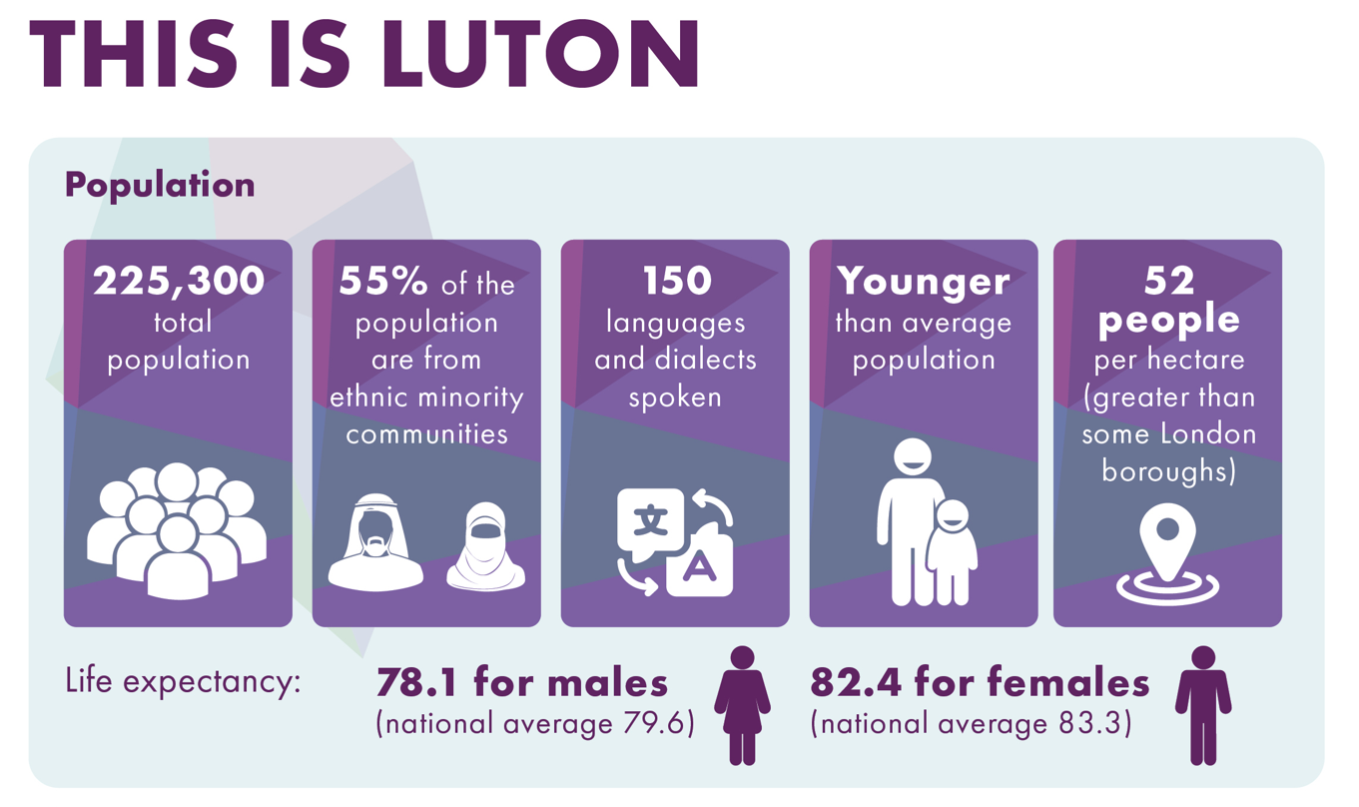

Slide 3
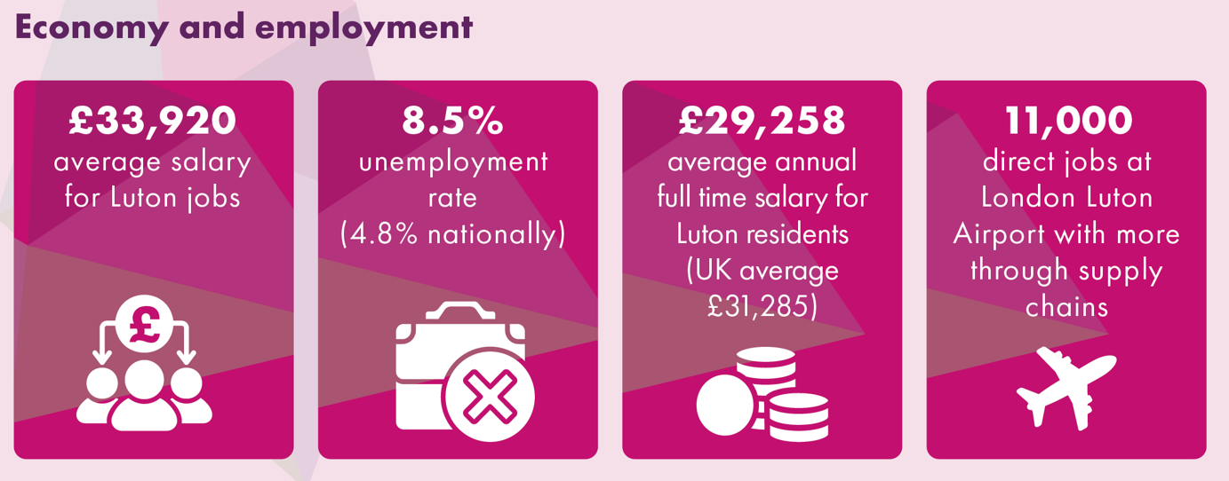

Slide 4
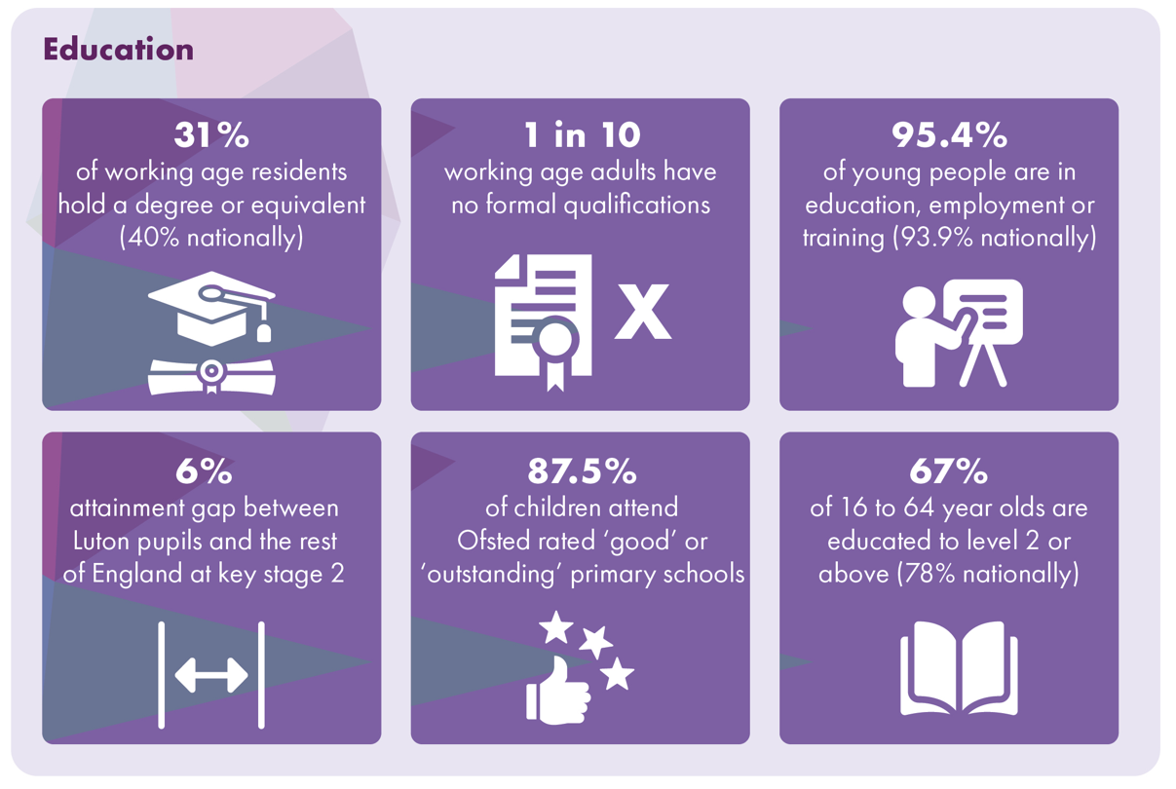

Slide 5
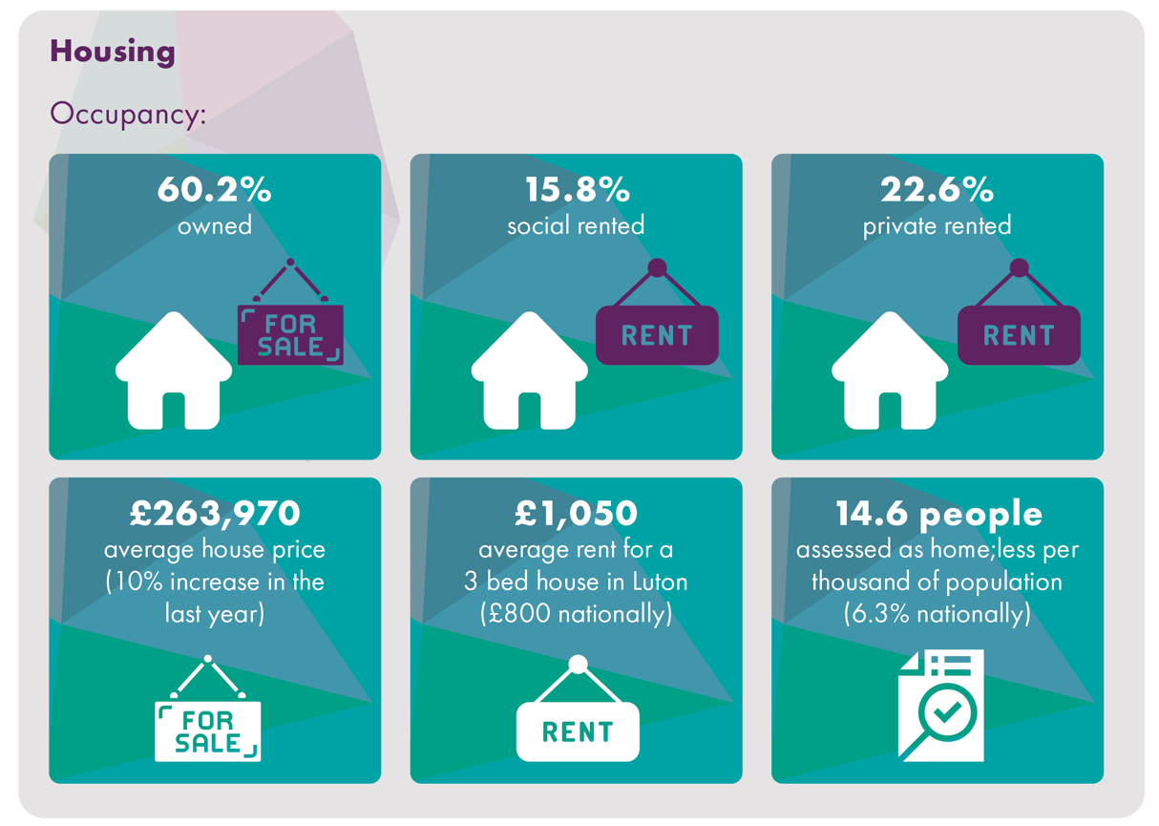

Slide 6
Our Team

Slide 7
LGA Corporate Peer Challenge
Robin Porter

Slide 8

Luton 2040 Pledges

Slide 9
Strengths, Assets, Challenges and Areas for Development

Slide 10
Our Corporate Strengths and Assets
Our community, culture and heritage
Vision and leadership
Systems leadership
London Luton Airport
Innovation and dedication
A grassroots approach
Continued Economic Growth
Resilience

Slide 11
Luton in 2024
Luton has the highest net new job creation in British cities and large town 2010-2022, even ahead of London
Luton has the second highest business start-up rate in the country
Luton has the third lowest emissions per capita in the country
93% of our schools are good or outstanding
Our own home-grown Premier League Football Club
The third most generous community in the country
Levelling Up Priority 1 area, Priority Place for ACE

Slide 12
Our greatest challenge - Poverty
39% of children in Luton live in poverty, a drop from the previous figure of 45% – 24,155 growing up in households who can’t afford basic essentials
8.9% of Luton households live in destitution and a further 11.8% of households are struggling to pay for some basic essentials (moved from 61st worst in the country for destitution in 2020 to 10th worst)

Slide 13
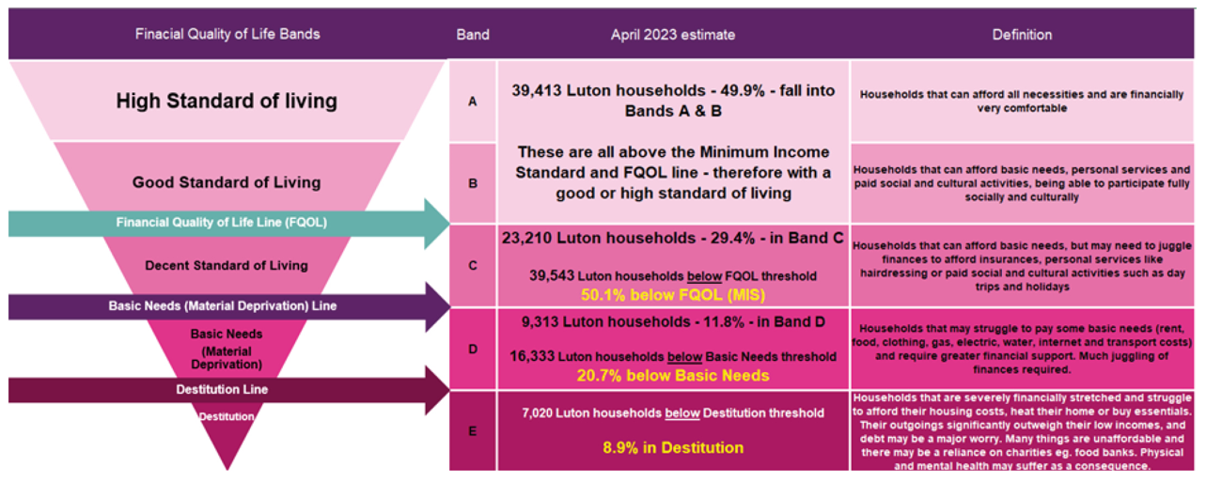
Our greatest challenge - Poverty

Slide 14
Poverty – Drivers and Impact
Housing and homelessness
Low paid work
Population churn
Health inequalities, disability and ill-health
Inadequate social security and families with high numbers of dependents
Lack of central government funding
Home Office’s Asylum policies
Problematic debt
Demand pressures
Quality of life

Slide 15
Social Progress

Slide 16
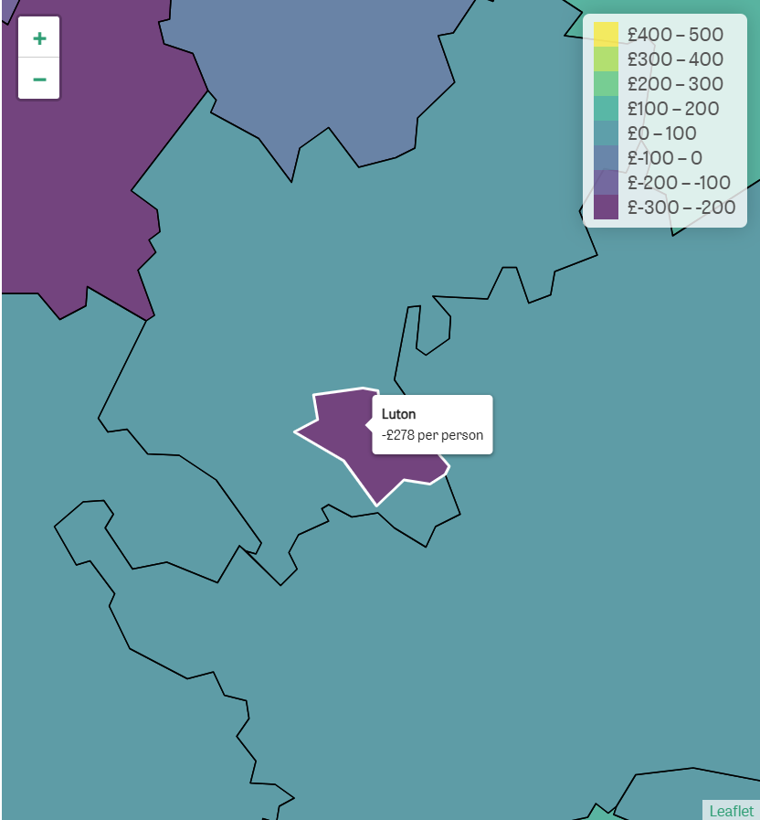
Central Government Funding

Slide 17
Areas for further development
Our resources and systems don't always match our ambition
We need to continue to evolve and strengthen the 2040 governance
We need to further develop our approach to working together with residents
Continue to develop partnerships
We need to become more data led
We need to be less self-effacing; shout louder; and have bigger Regional and National voice
Council Support Services

Slide 18
Our response – Luton 2040
Luton to be a place where everyone can thrive and no one lives in poverty

Slide 19
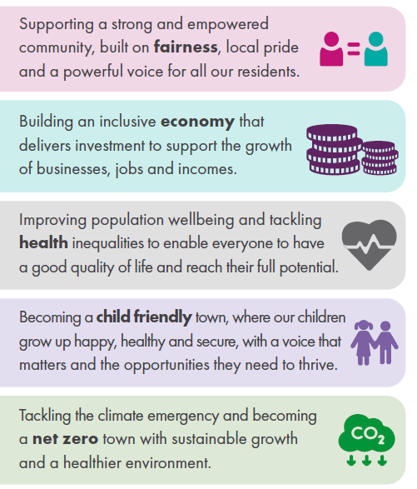


Slide 20
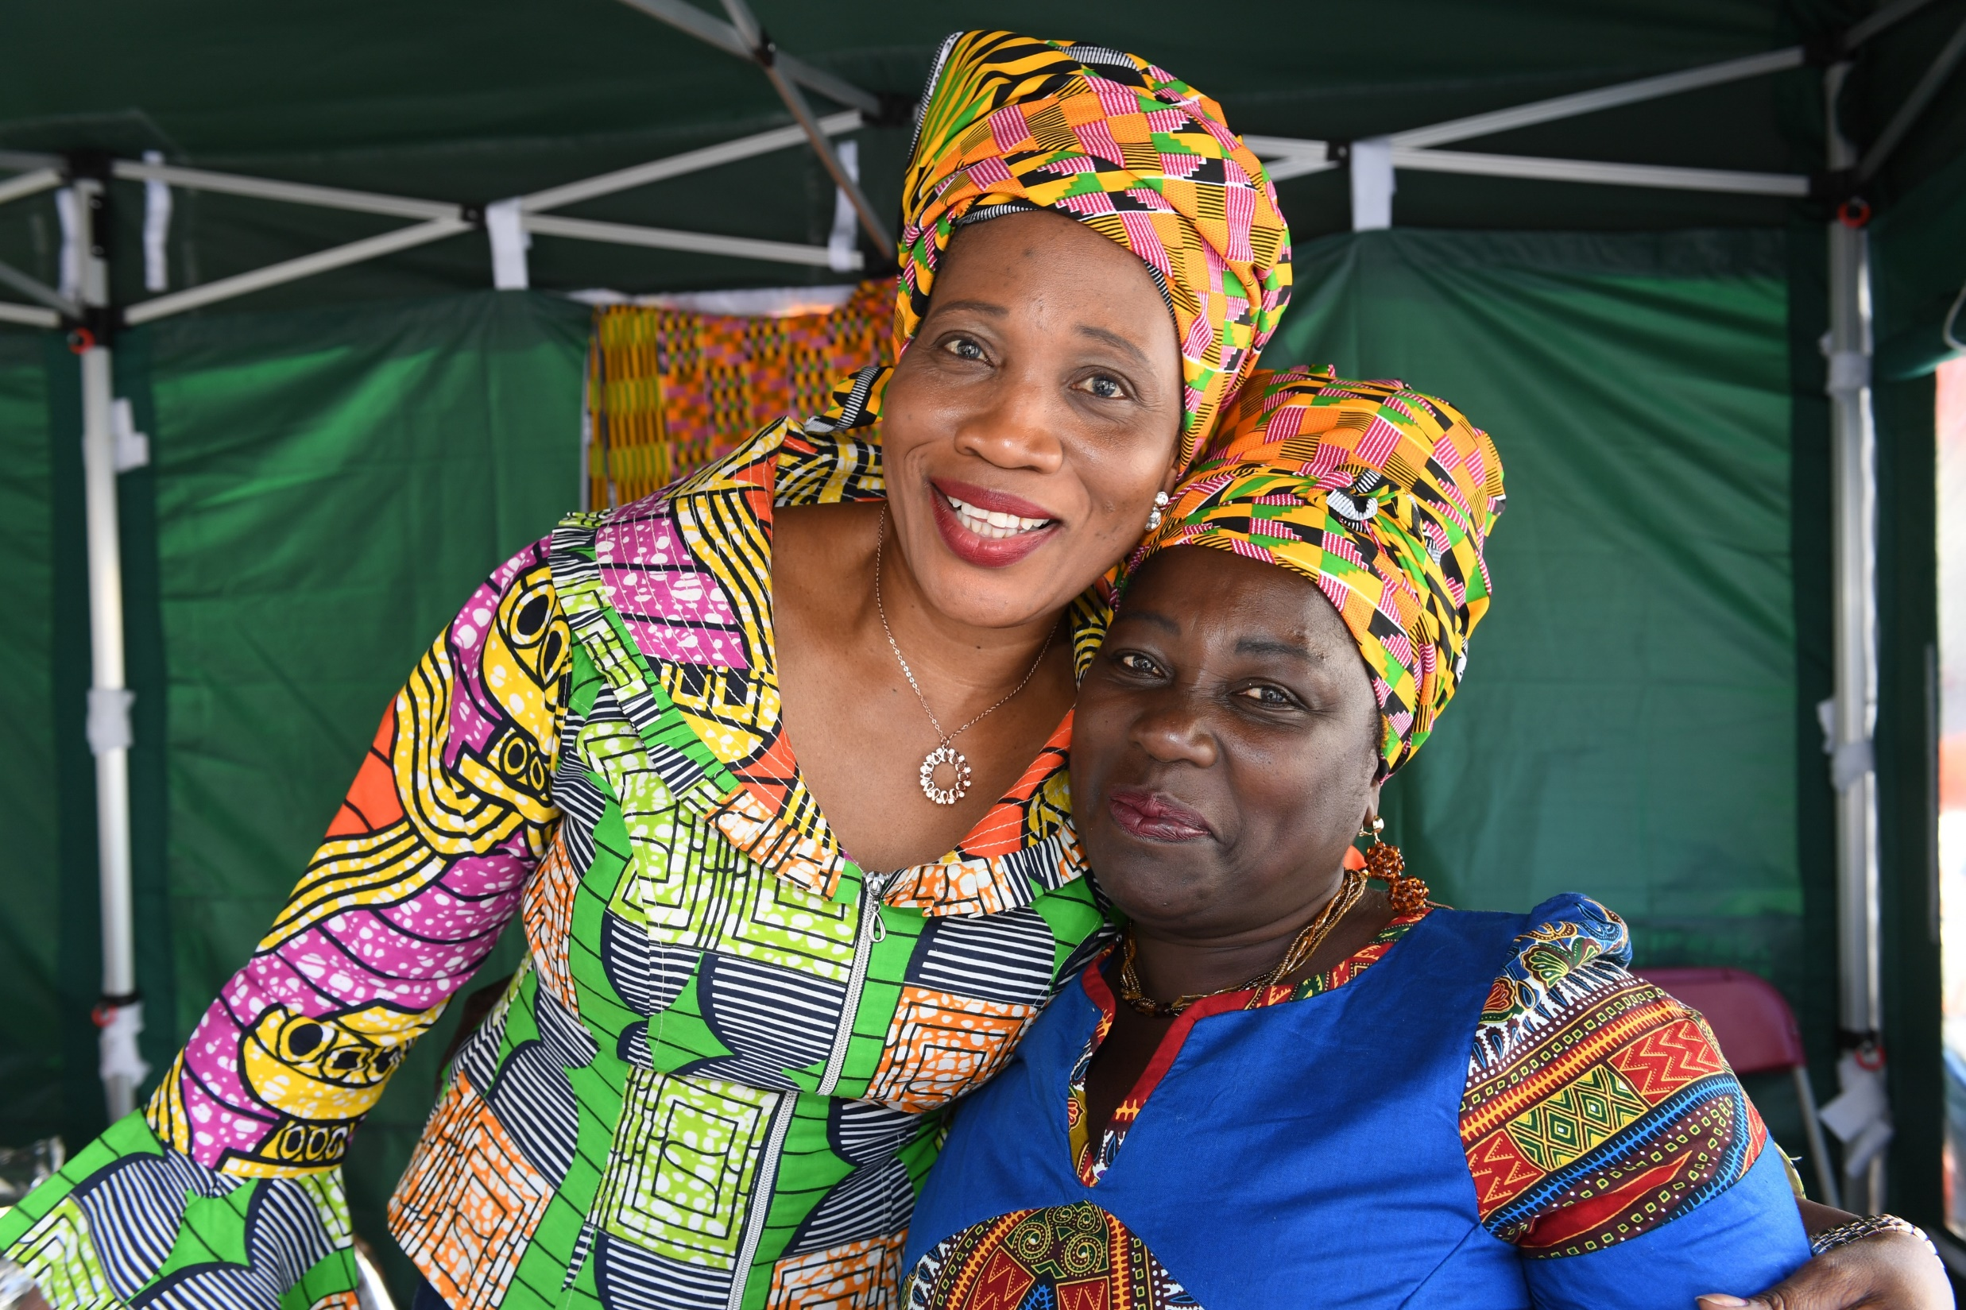
Population Wellbeing
Image: Volunteers at Luton Food Festival 2019

Slide 21
Improving Population Wellbeing
Award winning cancer outcomes programme, with additional funding for cancer connectors
Working with Institute of Health Equity to create a Health Equity Town (embedding Marmot principles)
The Denny Report on health inequalities across BLMK
Refreshed Population Wellbeing Strategy, given focused actions across the life course

Slide 22
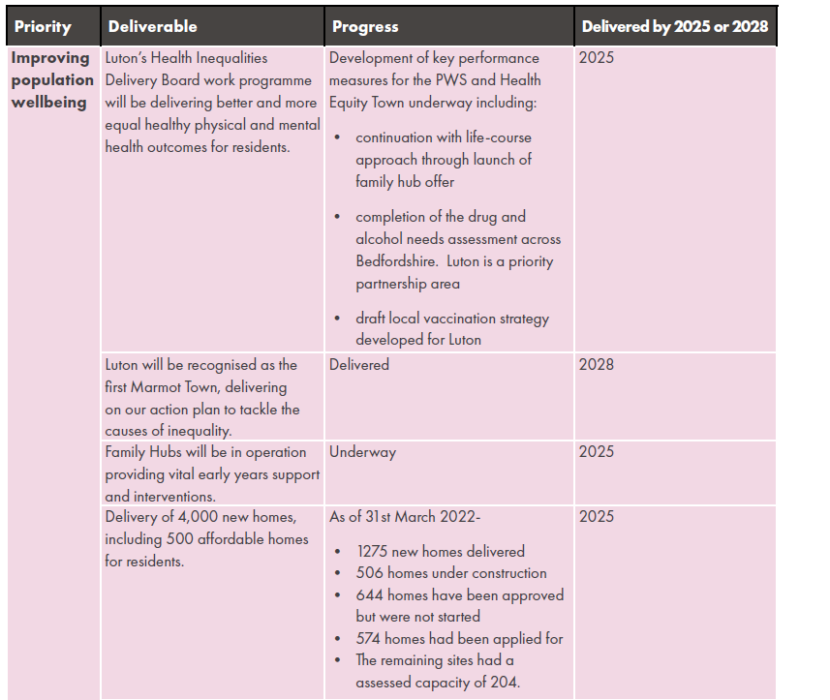
Improving Population Wellbeing

Slide 23
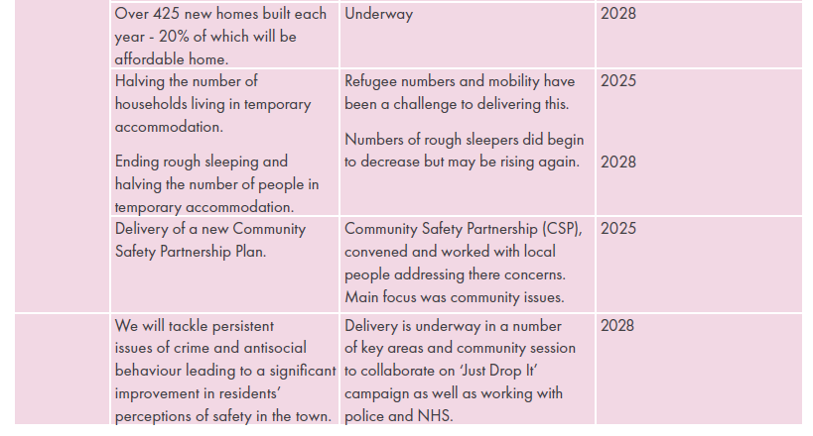
Improving Population Wellbeing

Slide 24
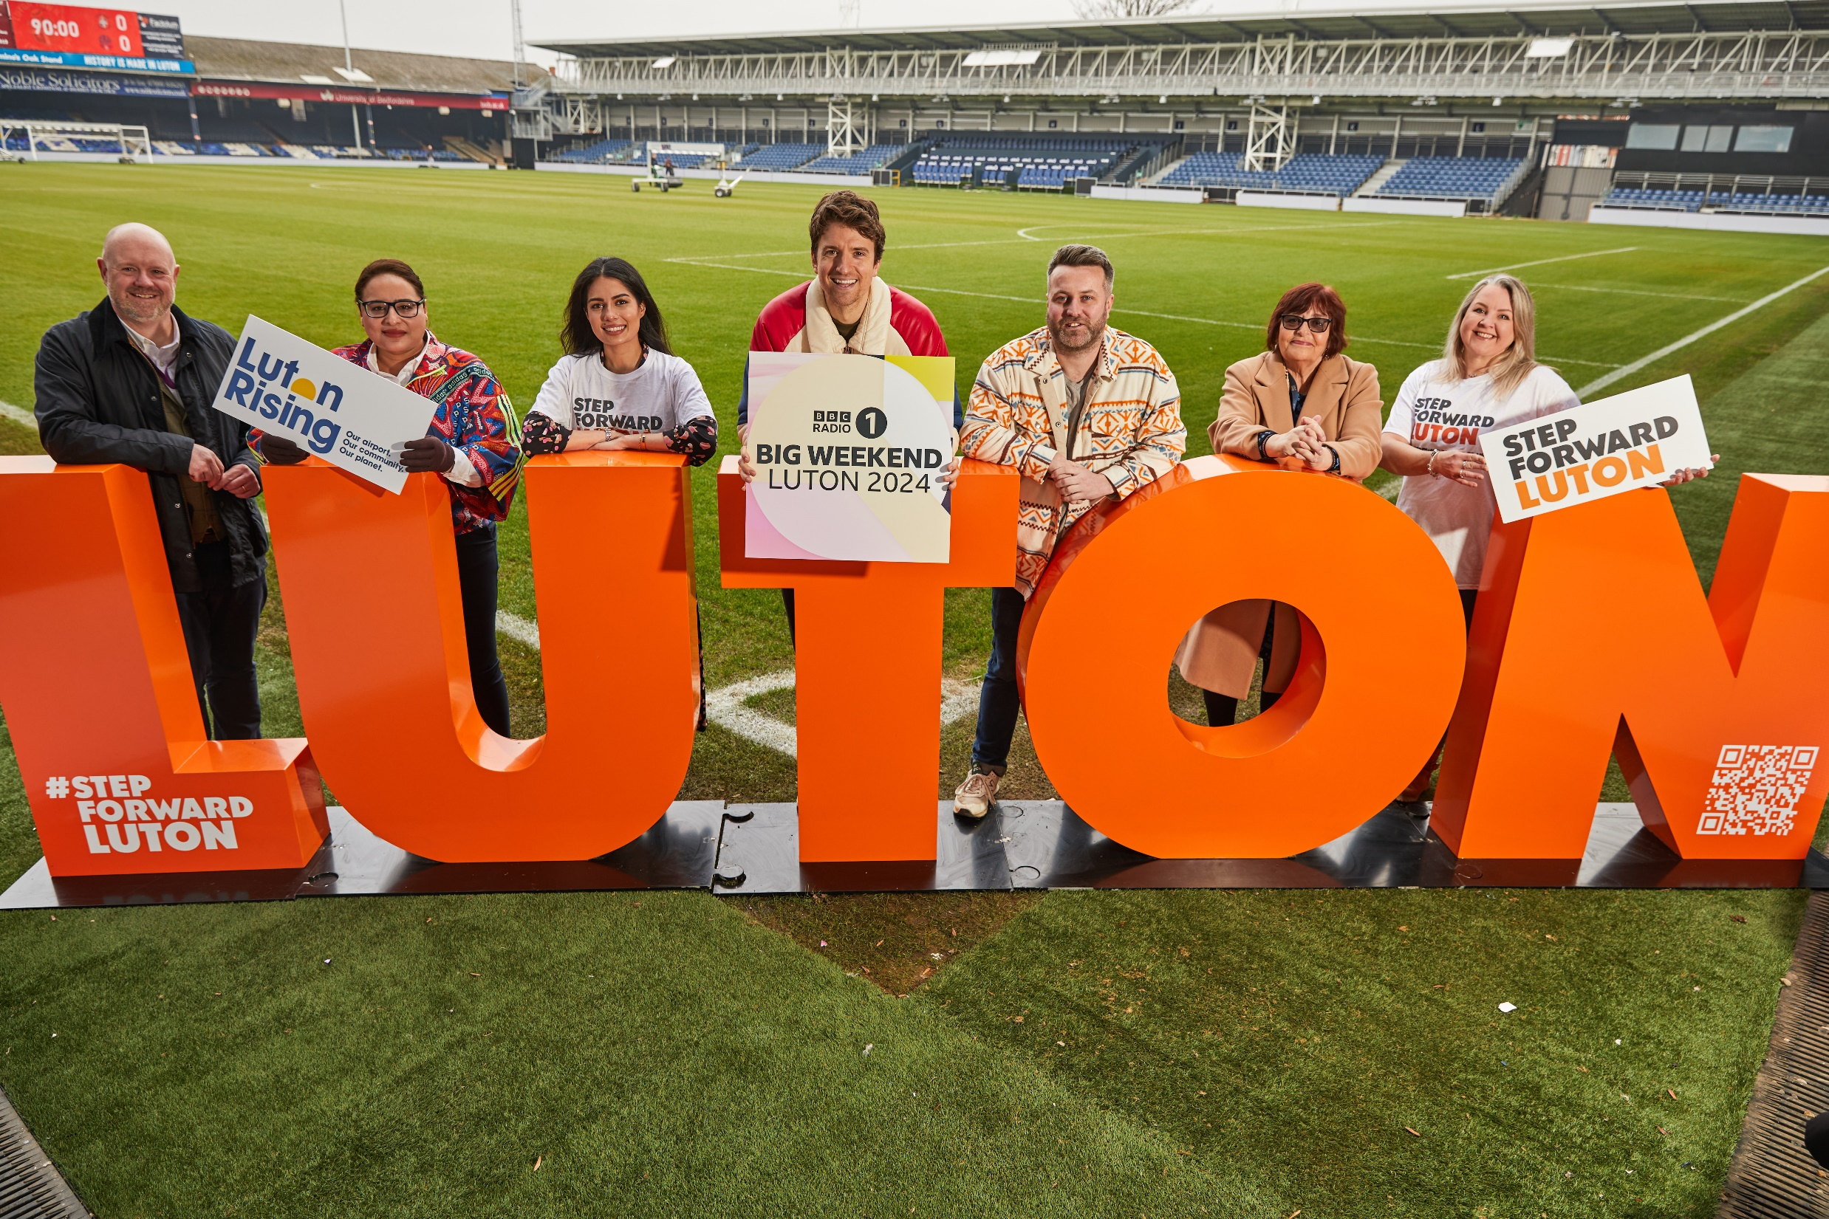
Inclusive Economy
Announcement of BBC Radio 1’s Big Weekend coming to Luton

Slide 25
Building a more inclusive economy
Opening of DART, high-speed, electric transport to Luton Airport
Over the last decade, Luton has seen a significant drop in the percentage of the working age population without qualifications, from 18% in 2011, to 9.8% in 2021.
Allocated £2.9m from UKSPF and £1.1m from Multiply.
Opening up of Hat Gardens
Launch of our new place brand – Step Forward Luton

Slide 26
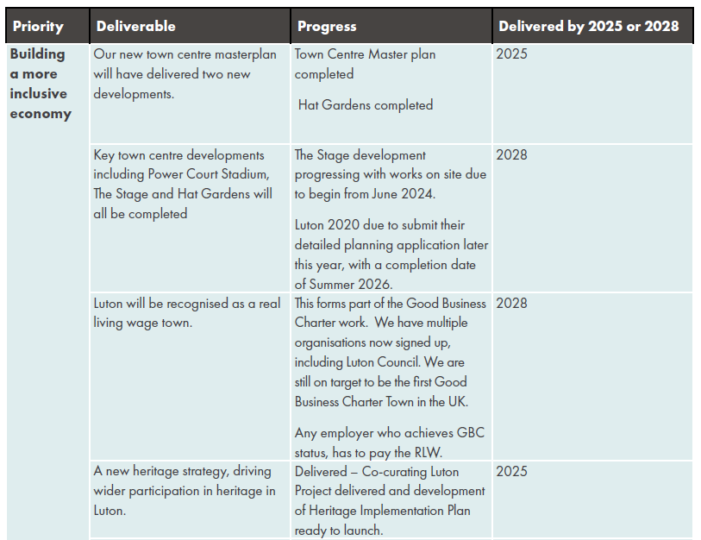
Building a more inclusive economy

Slide 27
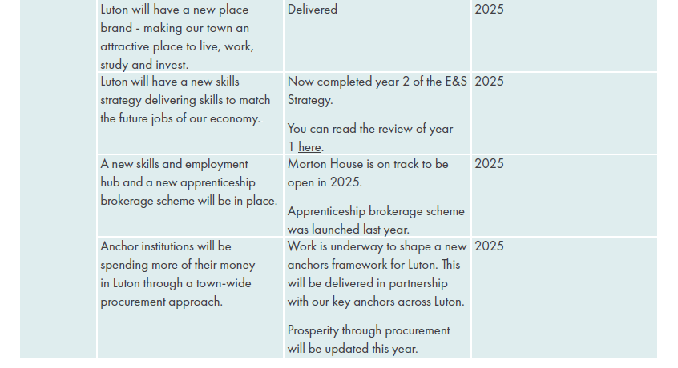
Building a more inclusive economy

Slide 28
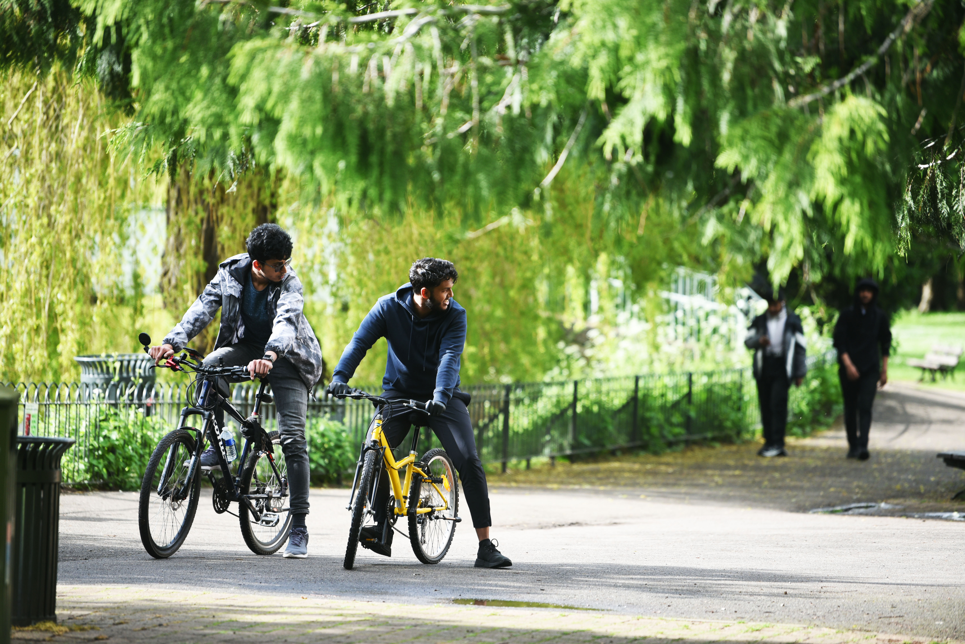
Net Zero
Wardown Park

Slide 29
Becoming a Net Zero Town
Green Controlled Growth Framework introduced as part of the Airport Expansion Plans
£7.7m Salix Grant to decarbonise public Sector buildings
Luton Station accessibility project underway
All street lights converted to LED’s
Net Zero roadmap established
Council housing has average EPC rating of C, with plans to develop this
further through our Retrofit Show Home

Slide 30
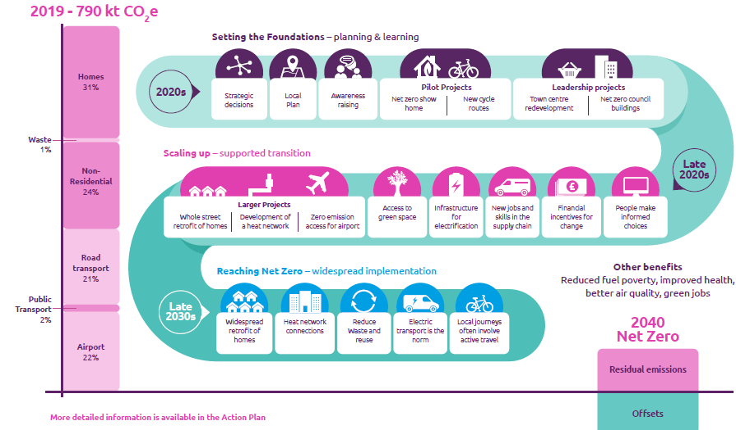
Becoming a Net Zero Town

Slide 31
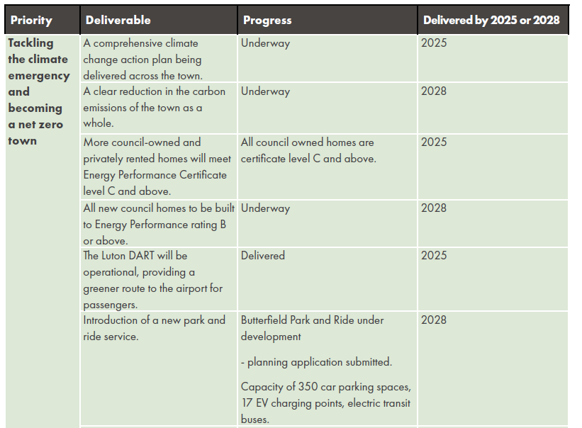
Becoming a Net Zero Town

Slide 32
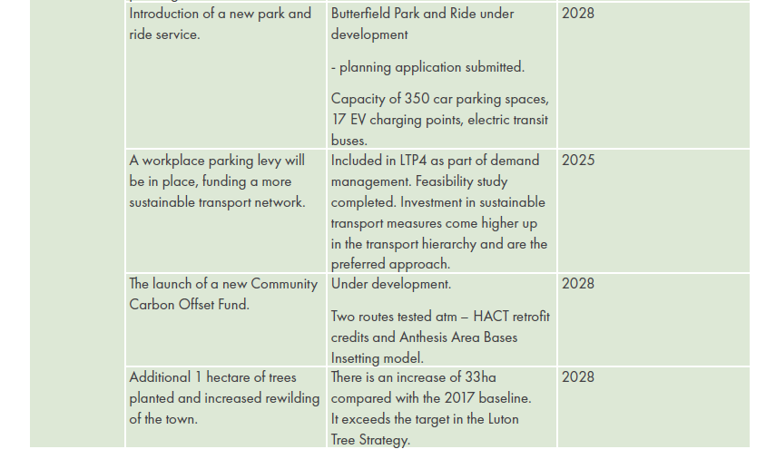
Becoming a Net Zero Town

Slide 33
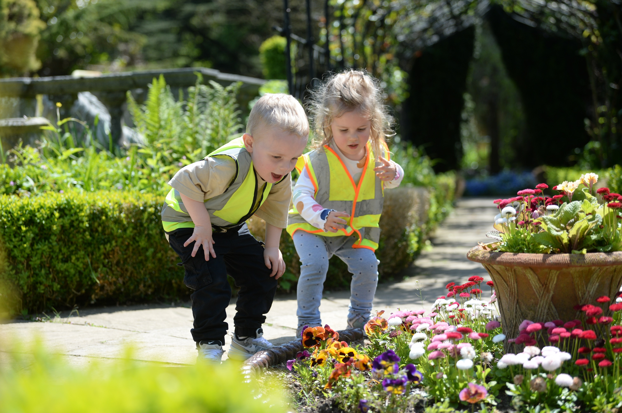
Child friendly town
Stockwood Park Discovery Centre

Slide 34
Child-friendly town
Entering into a formal relationship with UNICEF to develop our child friendly town programme
85.4% of children in Luton achieving a good level of development at 2 to 2½ years compared to 81.1% nationally
61.4% of Key Stage 2 reading, writing and maths measured at expected and above – beating our target
Key Stage 4 - Consistent improvement over time - best results ever in 2023 - now in line with national
Barnfield College’s £25m redevelopment
£2m investment in play areas
Continuous improvement across Children Families and Education department

Slide 35
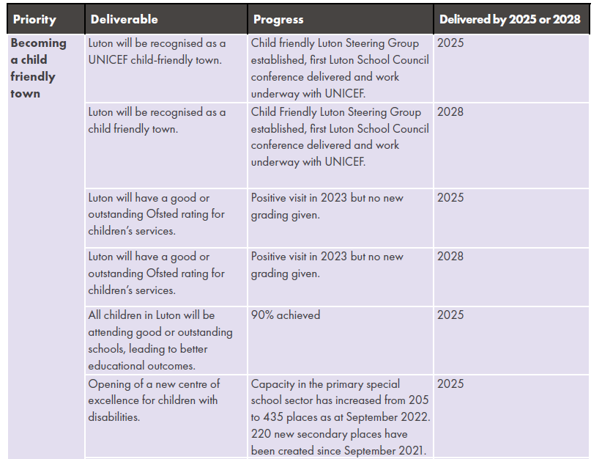
Child-friendly town
93%
93%

Slide 36
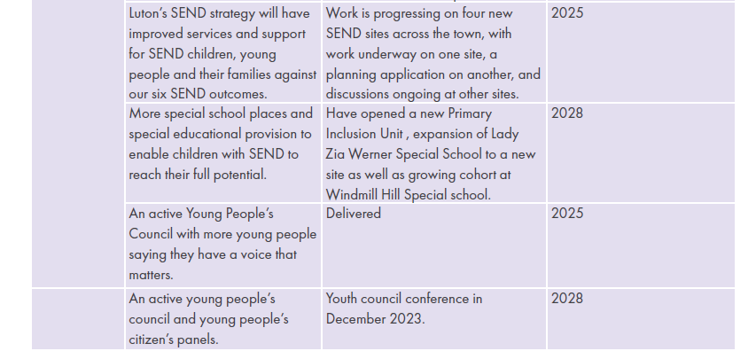
Child-friendly town

Slide 37
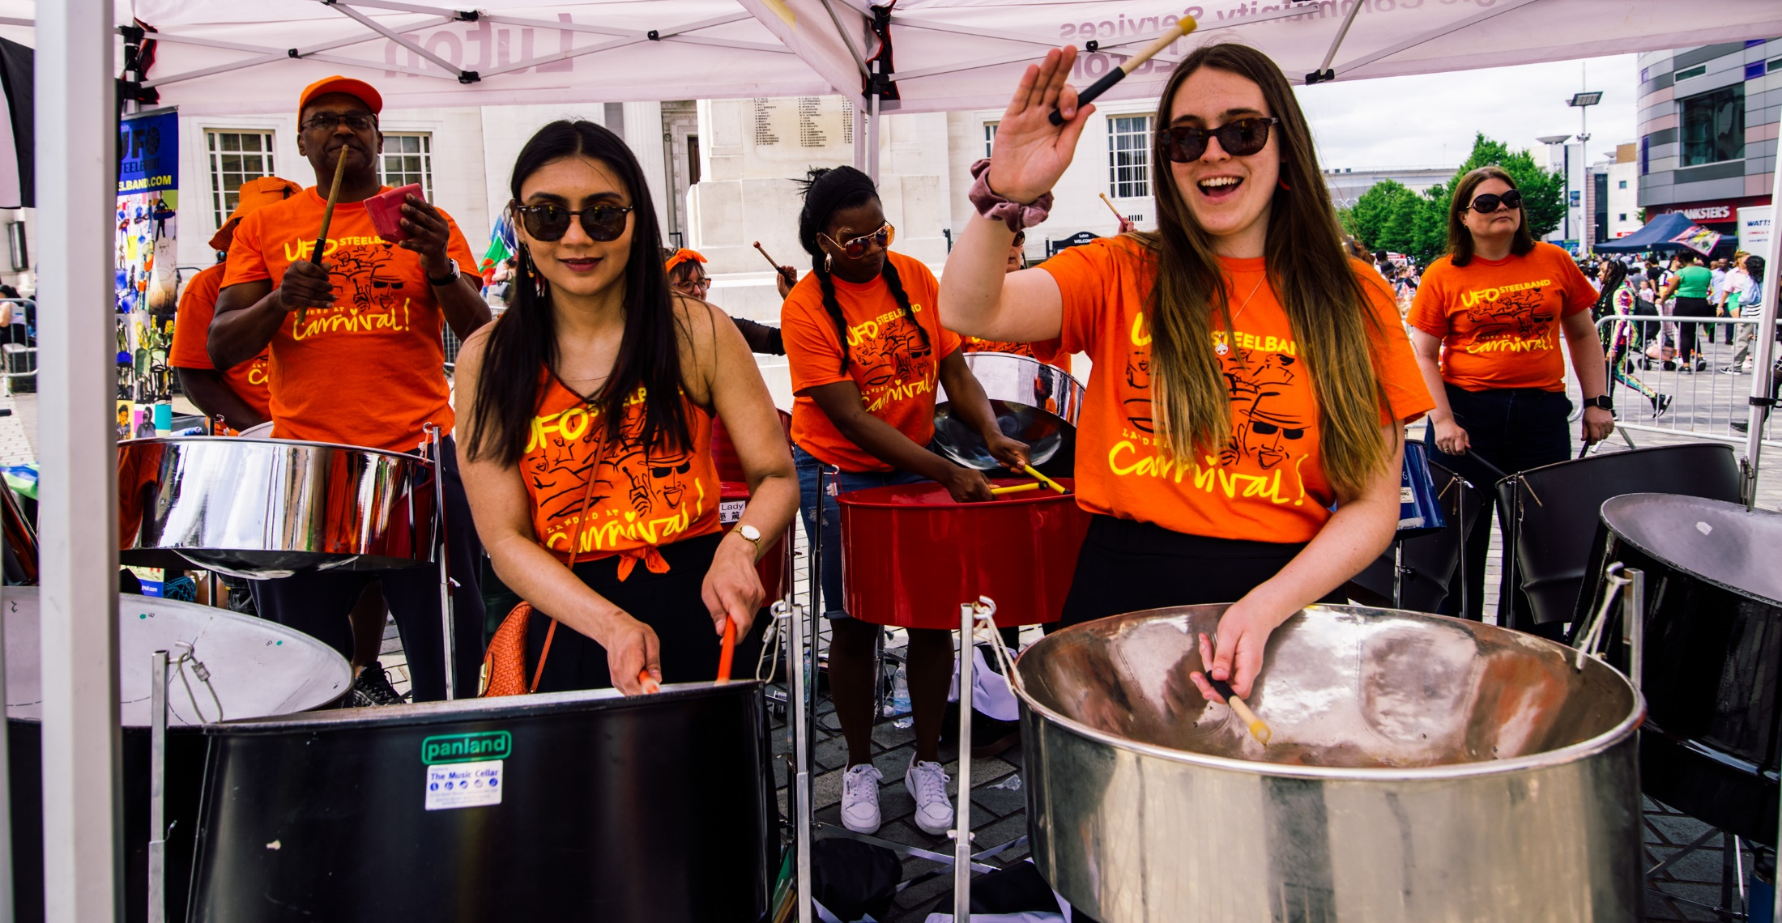
Empowered Community
Carnival Performers 2023

Slide 38
Strong, empowered community
Fairness Taskforce launched and delivering focused work on difficult issues
Collaboration Fund launched
Youth-led research intro fairness and justice in criminal justice system
53p per passenger invested into Luton by Luton Rising,
  26 times more than any other airport
37 warm hubs providing support to 3,000 residents in January

Slide 39
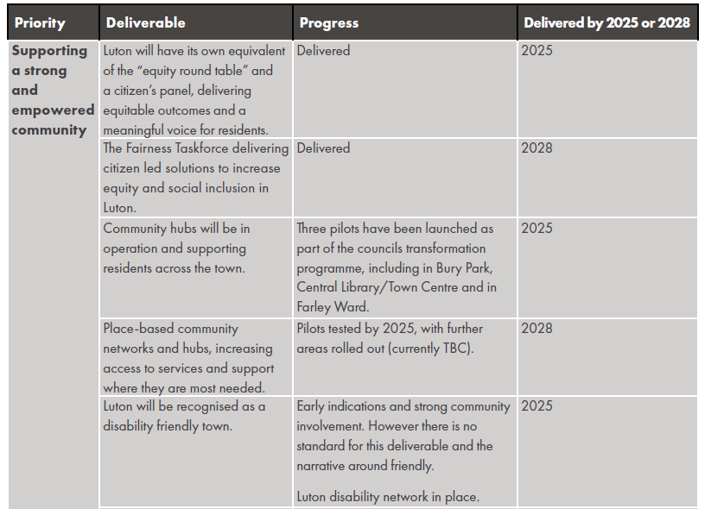
Strong, empowered community

Slide 40
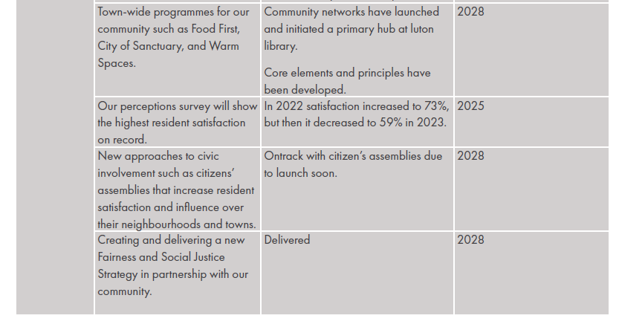
Strong, empowered community

Slide 41
Thank you for coming to Luton

