Slide 1
System and council strategic development

Slide 2
OSB to recommend that we…
…implement the council’s
  1. strategic framework,
  starting with adoption of the new
  2. planning and reporting cycle
  Agree a set of quarterly
  3. performance measures
support the leadership of the system by agreeing a set of
4. system-wide 2040 measures and outcomes
implement the proposed governance structure for Luton 2040, including the
5. establishment of the Luton 2040 Partnership.
and work with them to develop and oversee a tangible
6. road map to Luton 2040

Slide 3

Strategic Framework

Slide 4
Strategic
Framework
1 Vision
1 Corporate plan
6 strategies
85 Plans and 55 policies

Slide 5
Planning and reporting cycle
Frequency
Reporting
1 Vision
Annual 2040 Progress Report
Every 4 years
1 Corporate plan
Annual council Report
Every 4 years in response to elected manifesto
6 strategies
Annual Strategy Progress Reports
Every 4 years
85 Plans and 55 policies
Budget Setting
Corporate Delivery Plan
Quarterly corporate performance, finance and delivery reports
Every year
Service Plans

Slide 6

Measures
1 Vision
2040
Measures
Quarterly Corporate Performance Measures
Plan or service level measures
Annual Corporate Reporting Measures
Team and individual targets
1 Corporate plan
6 strategies
85 Plans and 55 policies

Slide 7
Annual Corporate Reporting Measures
 | What do we want to know about the impact our work is having | Measure to give an indication of this
1 | The quality of education provided by schools | Measure awaiting outcome on government update of OFSTED ratings
2 | The outcomes schools achieve for children at primary stage | Percentage of children achieving expected levels at key stage 2 reading, writing and maths.
3 | The outcomes schools achieve for children at secondary stage | GCSE results - attainment 8
4 | Our success at providing employment opportunities for children in care | Number of care leavers applying for council jobs and the number of care leavers getting council jobs.
5 | The quality of the care provided for looked after children | % of children who say they are satisfied with the care provided.
6 | How successful we are at keeping children within family networks | % of children cared for by extended family
7 | How successful we are at supporting children in care to achieve future success | % of children in care attending higher education
8 | How successful we are at supporting children to have stable loving homes | % of children in staying put arrangements
9 | Number of new family dwellings compared to total need from strategic housing market assessment (8500 homes over 20 years) | Completions of all 4-person 2 bed or more homes (from the authority monitoring report (AMR))
10 | Indication of our success in supporting business growth | Number of businesses or businesses starts up
11 | Indication of our success in influencing quality job growth | The % of key sector jobs (aviation, advanced manufacturing, digital & creative and construction)
12 | The cleanliness of our streets | % of Decent Streets - Litter and fly tipping
13 | Degree of contribution we are making to carbon offsetting | % Tree canopy coverage by hector (increase by 1 hector by 2025)
14 | Reduction in car emissions through less car usage | Meters of footpath, cycle path and no vehicle zone resurfaced or built
15 | Timeliness of adult social care response | Percentage of people have their initial assessment completed within 28 days of referral
16 | How well we are supporting residents to stay active | Proportion of adult population physically active
17 | Effectiveness of public health messaging | Visible decay at age 5
18 | Are we getting lifestyle prevention right? | Under 75 preventable mortalities
19 | How well we are supporting residents to eat healthily and exercise | Adult obesity

Slide 8
Quarterly Measures for CFE
No. | What do we want to know about the council’s performance? | Measure to give an indication of this
1 | How inclusive schools are and how well they use support to respond to children's needs | Number of exclusions
2 |  | Number of exclusions in children with SEND
3 | How successful we are at supporting young people into employment and training | NEET %
4 | Whether we are identifying children’s needs early and addressing challenges before they escalate | Number of families requiring statutory intervention
5 | The stability of placements for looked after children | % of placement changes for children in care
6 | Whether we are supporting children to have stable home | % of care leavers in suitable accommodation
7 | The success of our early intervention for children at risk of crime | First Time Entrance to Youth Justice System % variance change

Slide 9
Quarterly Measures for IE
No. | What do we want to know about the council’s performance? | Measure to give an indication of this
8 | How swiftly we are enabling developments | The speed with making decisions on planning application categories within the “Statutory Period”
9 | How good we are at getting the developments we want | The number of appeal decisions that are allowed
10 | How successful we are protecting our built heritage | Number of buildings on heritage at risk register
11 | The success of the support we offer people who are unemployed | Job seeker claimant Count % compared to national
12 | How successful we are at spending Luton Council funding within the town | The % of influenceable council spend through procurement spent locally
13 | Indication of how well we are supporting local people to pursue further skills and training | Number of people attending adult learning courses through Adult Learning
14 | Vibrancy of our Town Centre | % of unoccupied commercial and retail space in town centre
15 | The role the council plays in creating safe neighbourhoods | number of enforcement actions taken
16 | The progress we are making on Zero Waste requirements | Residual waste per head or household
17 | Provision of net zero infrastructure compared to national | Number of new electric charge points installed as compared to national
18 | The role the council plays in creating clean neighbourhoods | Number of complaints about street scene
19 | Resident perception of greener Luton goals | Number of complaints about grass length
20 | Amount of CO2 our fleet generate | (A) Scope 1 - Fleet fuel (tCO2)
21 | Carbon consumption across all corporate buildings | Electricity and Gas consumption of corporate buildings (tCO2)
22 | Carbon consumption of the goods and services we procure | Goods and services Scope 3
23 | Sustainability of council homes | EPC rating of council owned homes.
24 | Council contribution to number of new family dwellings compared to total need from strategic housing market assessment (8500 homes over 20 years) | Number of council created new family homes
25 | Do we have enough SEN places relative to need? | Number of SEN school places in relation to need

Slide 10
Quarterly Measures for PW
No. | What do we want to know about the council’s performance? | Measure to give an indication of this
26 | The quality of care provided by CQC registered care home providers | Percentage of CQC registered providers achieving a rating of ‘good’ or ‘outstanding’
27 | Whether people have control over how their care is arranged | Proportion of people accessing a direct payment
28 | That adults with care and support needs are made safe from harm. | The proportion of new section 42 safeguarding enquiries where a risk was identified, and the reported outcome was that this risk was reduced or removed
29 | That adults are supported to live in their own homes, maximising their independence | The number of adults aged 18 to 64 whose long-term support needs are met by admission to residential and nursing care homes (Number of individuals - low numbers indicate good
30 | Indication of supply of adequate supported housing as an alternative to residential care | Number of people receiving care and support to live independently
31 | The success of the support we provide people to live in a suitable home | Number of homes made decent and suitable through council support in the last quarter such as through warm and well and aids and adaptations
32 | The demand for housing | Number of households in temporary accommodation
33 | Whether we are addressing high levels of housing needs outside homelessness | Proportion of lets to people who have a high priority for housing not related to homelessness
34 | Quality of customer service we provide | % of overall customer satisfaction with customer services team
35 | Quality of customer service we provide | % of calls answered (50% of all calls to council)
36 | How well we treat complainants | % of complaints investigated on time
37 | Monitoring of serious service failures | Number of Ombudsman findings of fault
38 | Level of need and support provided to households in need | Number of households supported through the councils hardship schemes
39 | Success of the care we commission in reaching users | Estimated proportion of opiate and crack cocaine users who are not in treatment services
40 | Success of the breast-feeding support we provide | % breast feeding rates
41 | How successful we are at providing care for new mothers and babies | % of new births visits done in the first 14 days
42 | How successful we are at encouraging people to attend health checks | Number of NHS health checks and mini-MOT’s delivered
43 | How successful we are at encouraging people to attend HIV screening | % of HIV late diagnosis
44 | Effectiveness of the Community Safety Partnership | Number of domestic abuse crimes reported

Slide 11
Quarterly Enabling Services Measures
No. | What do we want to know about the council’s performance? | Measure to give an indication of this
45 | How effectively our legal services are performing | Legal performance dashboard - TBC
46 | Sentiment towards council on social media | % of positive sentiments towards the council across social media
47 | Our consideration of EDI implications within policy decisions | % of IIA's completed within specified council standard
48 | Our effectiveness in supporting the system to deliver to 2040. | The % of 2040 targets on track
49 | How inclusive we are as an organisation | % of all M6 and above that are Female, global majority, LGBTQplus, disability
50 | Indication of how well we manage employee performance | % of staff performing well
51 | Indication of how well we use our money on apprenticeships | % of apprenticeship levy spent
52 | Health and wellbeing of employees | Average days of sickness over the last 12 months
53 | Security of workforce (10% is healthy) | % of workforce that are agency or interim
54 | Indication of how strong our recruitment, induction and culture are | % voluntary turnover within 12 months of joining
55 | Whether employees satisfied with the IT service they receive? | IT customer satisfaction - Net Promoter Score - speak to Kate about whether they can/would have this.
56 | How well is the IT infrastructure working? | Availability of core network
57 | Are public customers able to use online services? | Number of online customer (public customer) transactions
58 | How well we are delivering on our strategic objectives for new houses and new businesses to the town. | Growth in council tax % (year on year increase on the number of properties in the borough)
59 |  | Growth in NDR base % (year on year increase on the number of properties in the borough)
60 | Return on the shareholders’ investment in its airport company | LR income % of overall income?
61 | Progress of delivery on agreed deficit recovery plans | Proportion of banked ongoing savings compared with target
62 | How effective are we at collecting rates and taxes | % of business rate we collect
63 |  | % of council tax we collect
64 | Are we covering the increase in the cost of providing services due to increases such as inflation and pay awards? | Actual income sales fees and charges

Slide 12

Top 6 2040
Measures

Slide 13
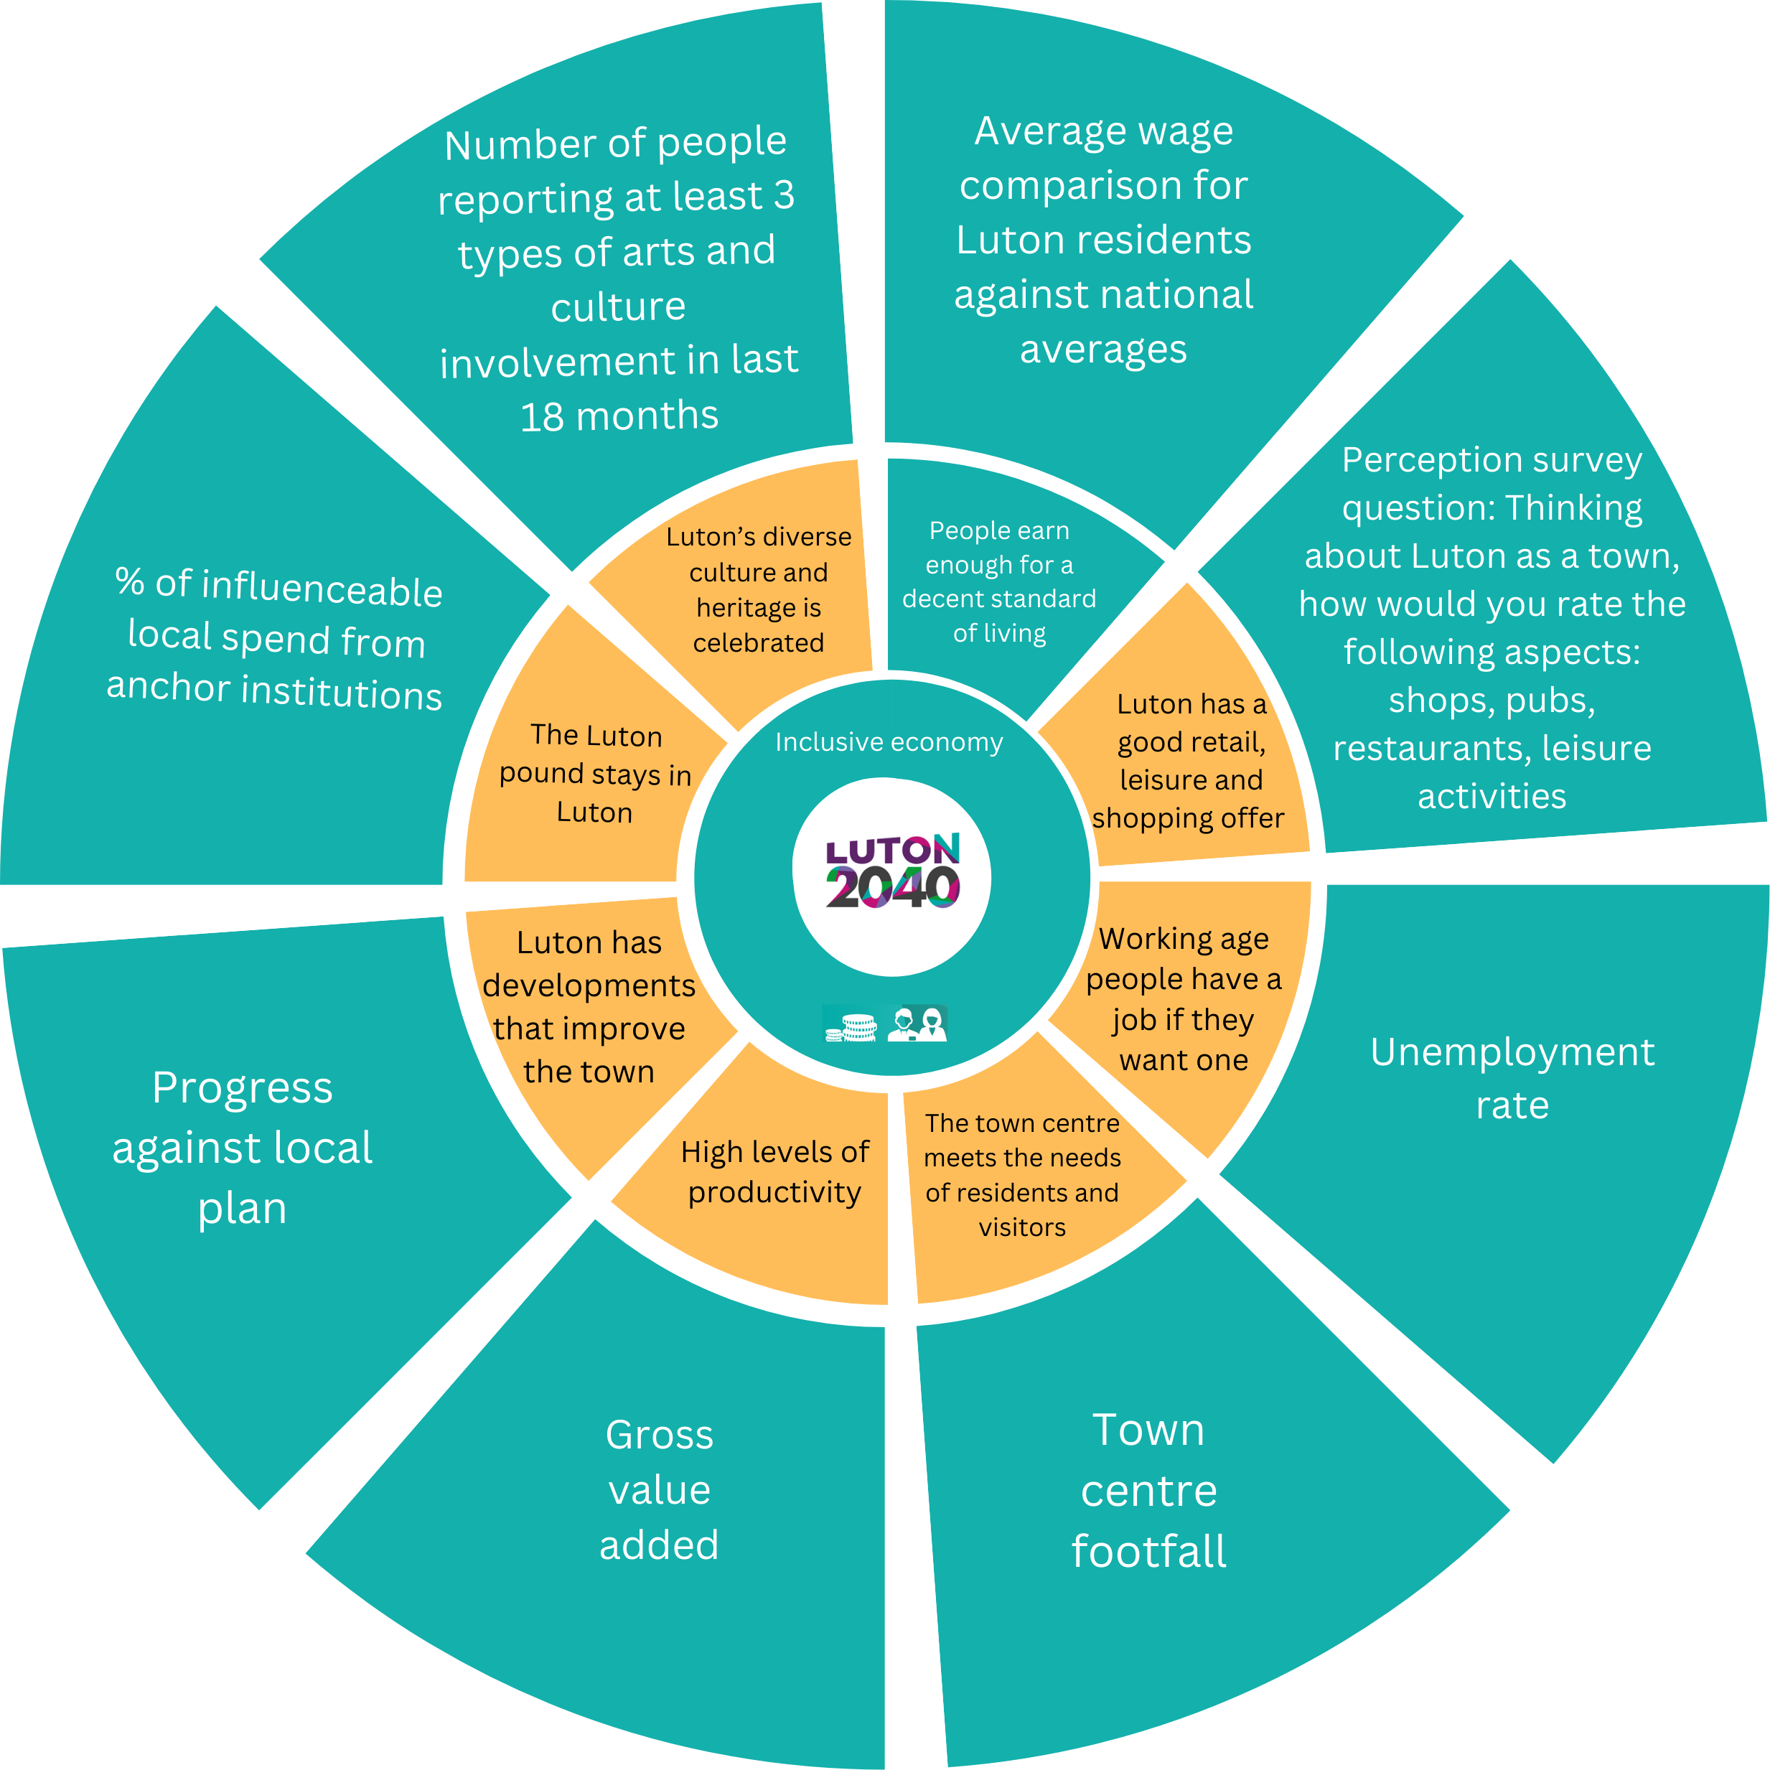
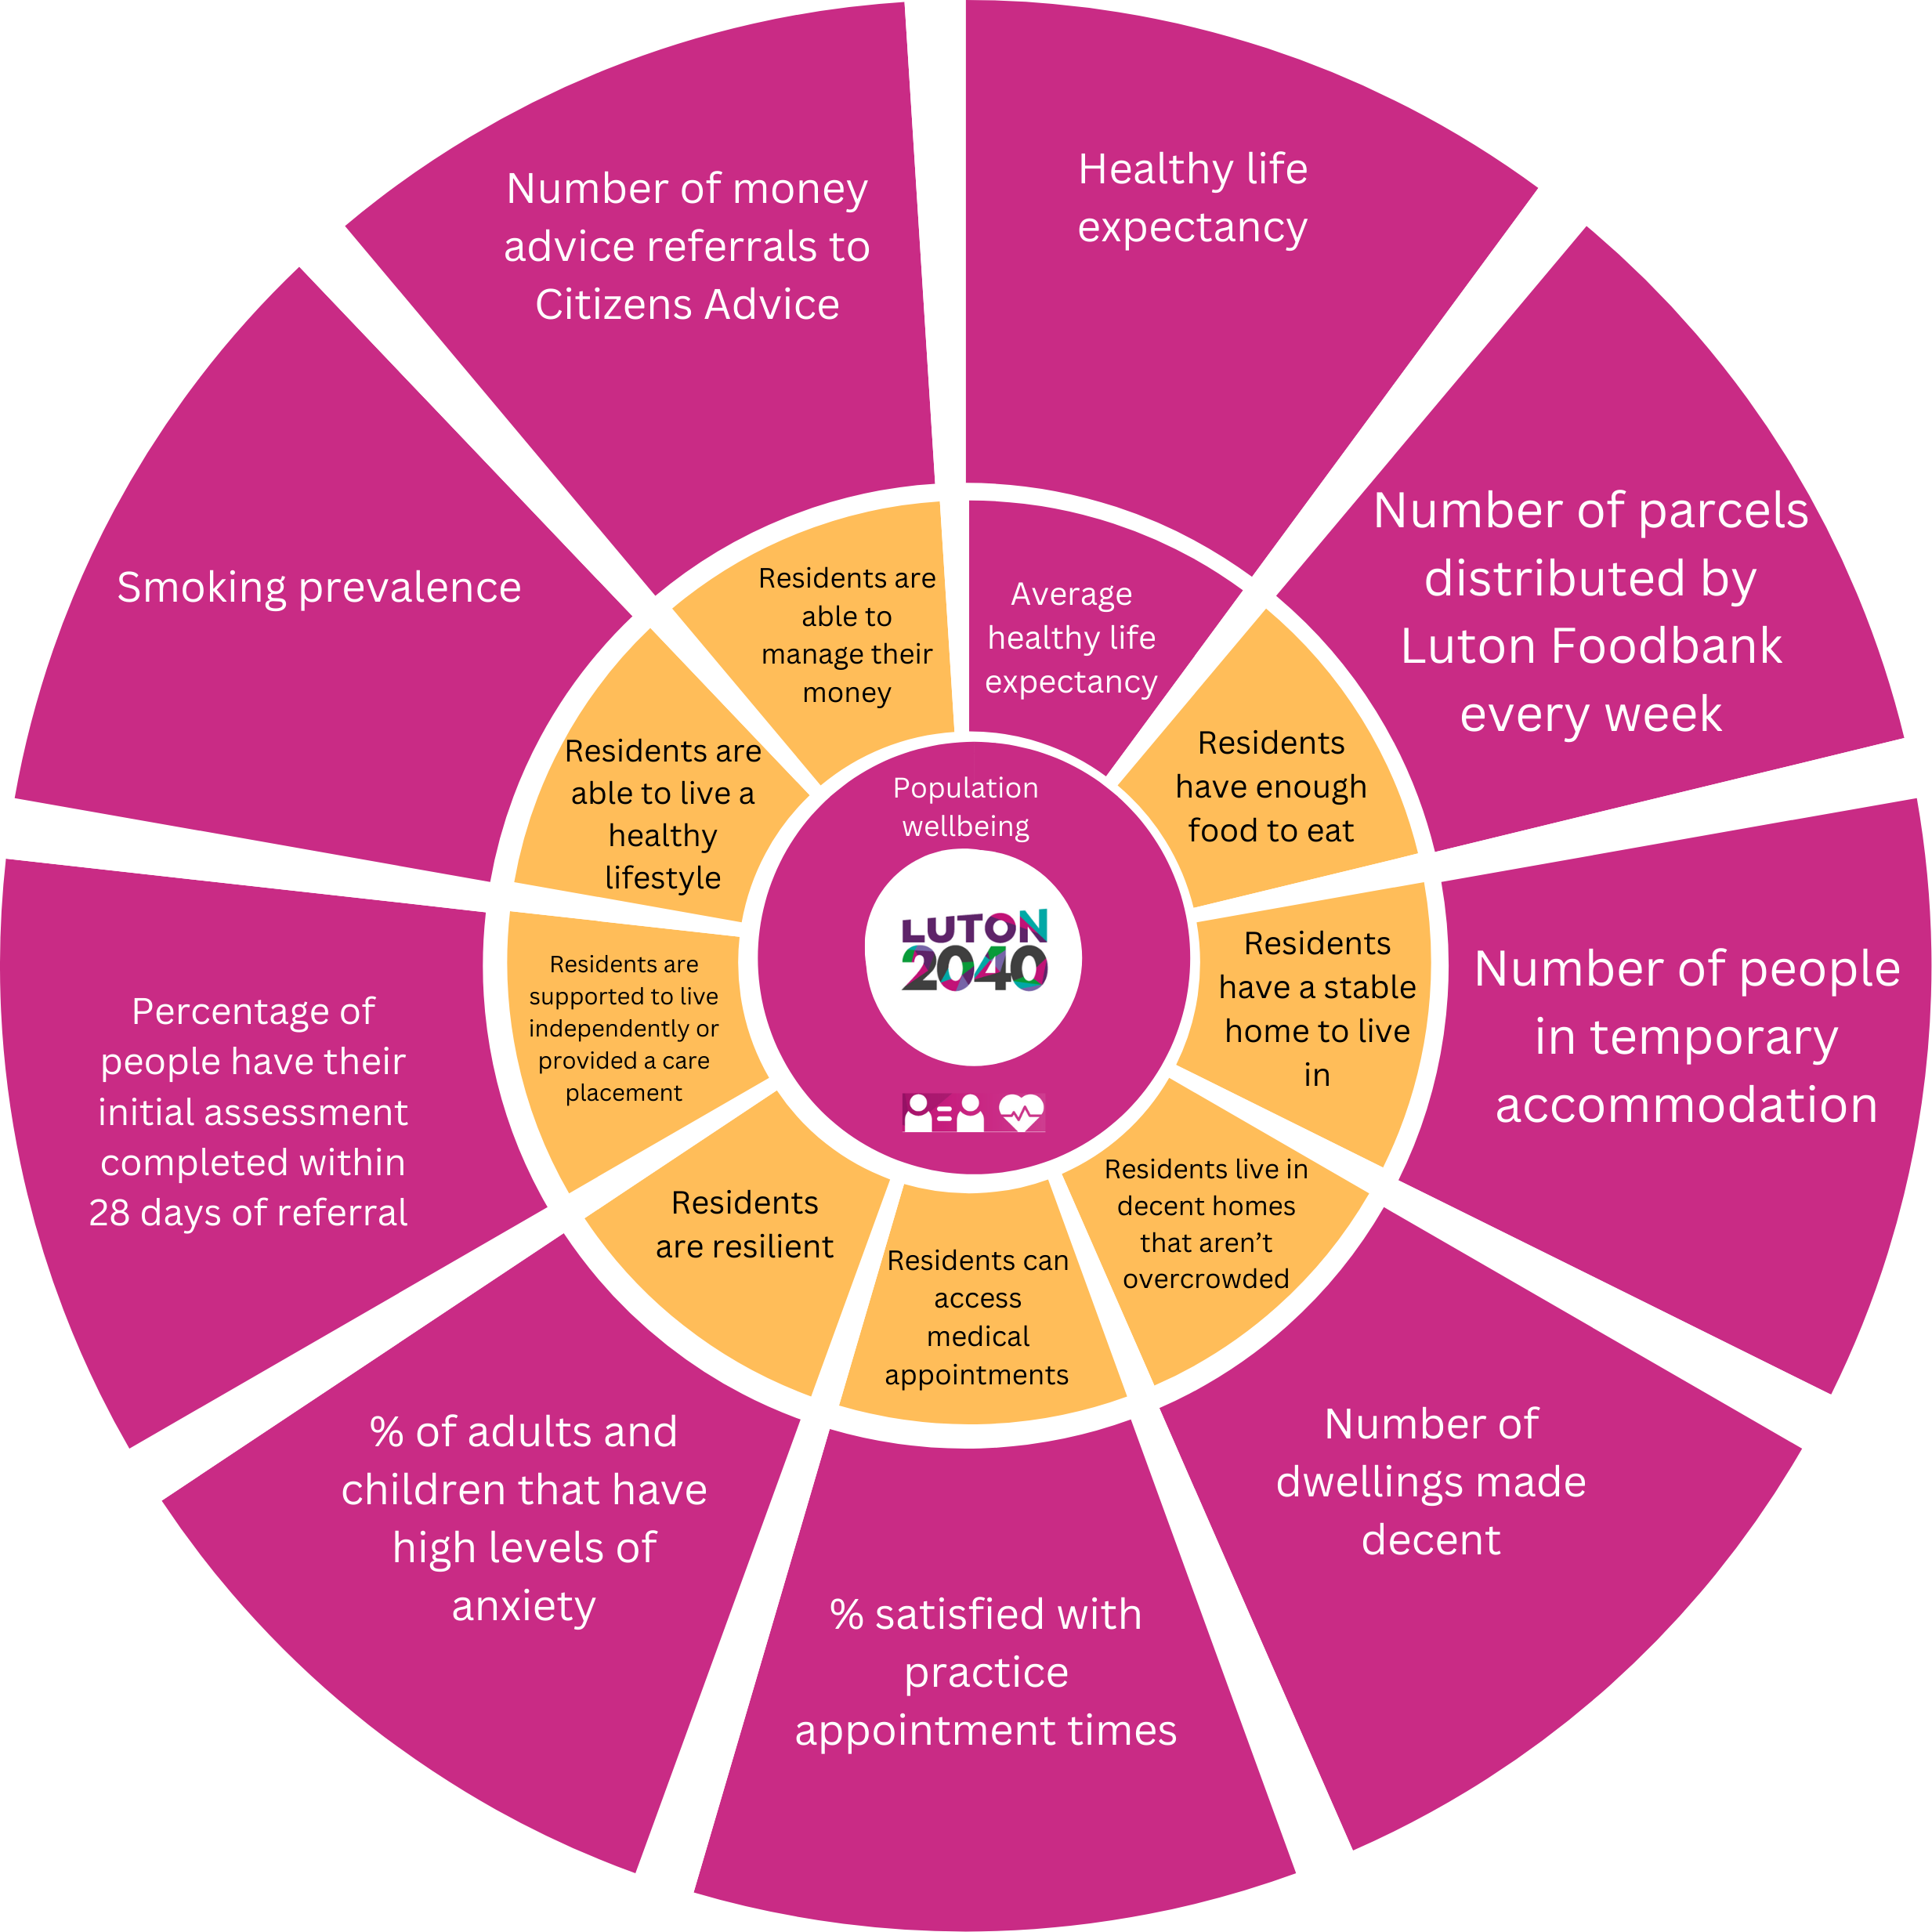
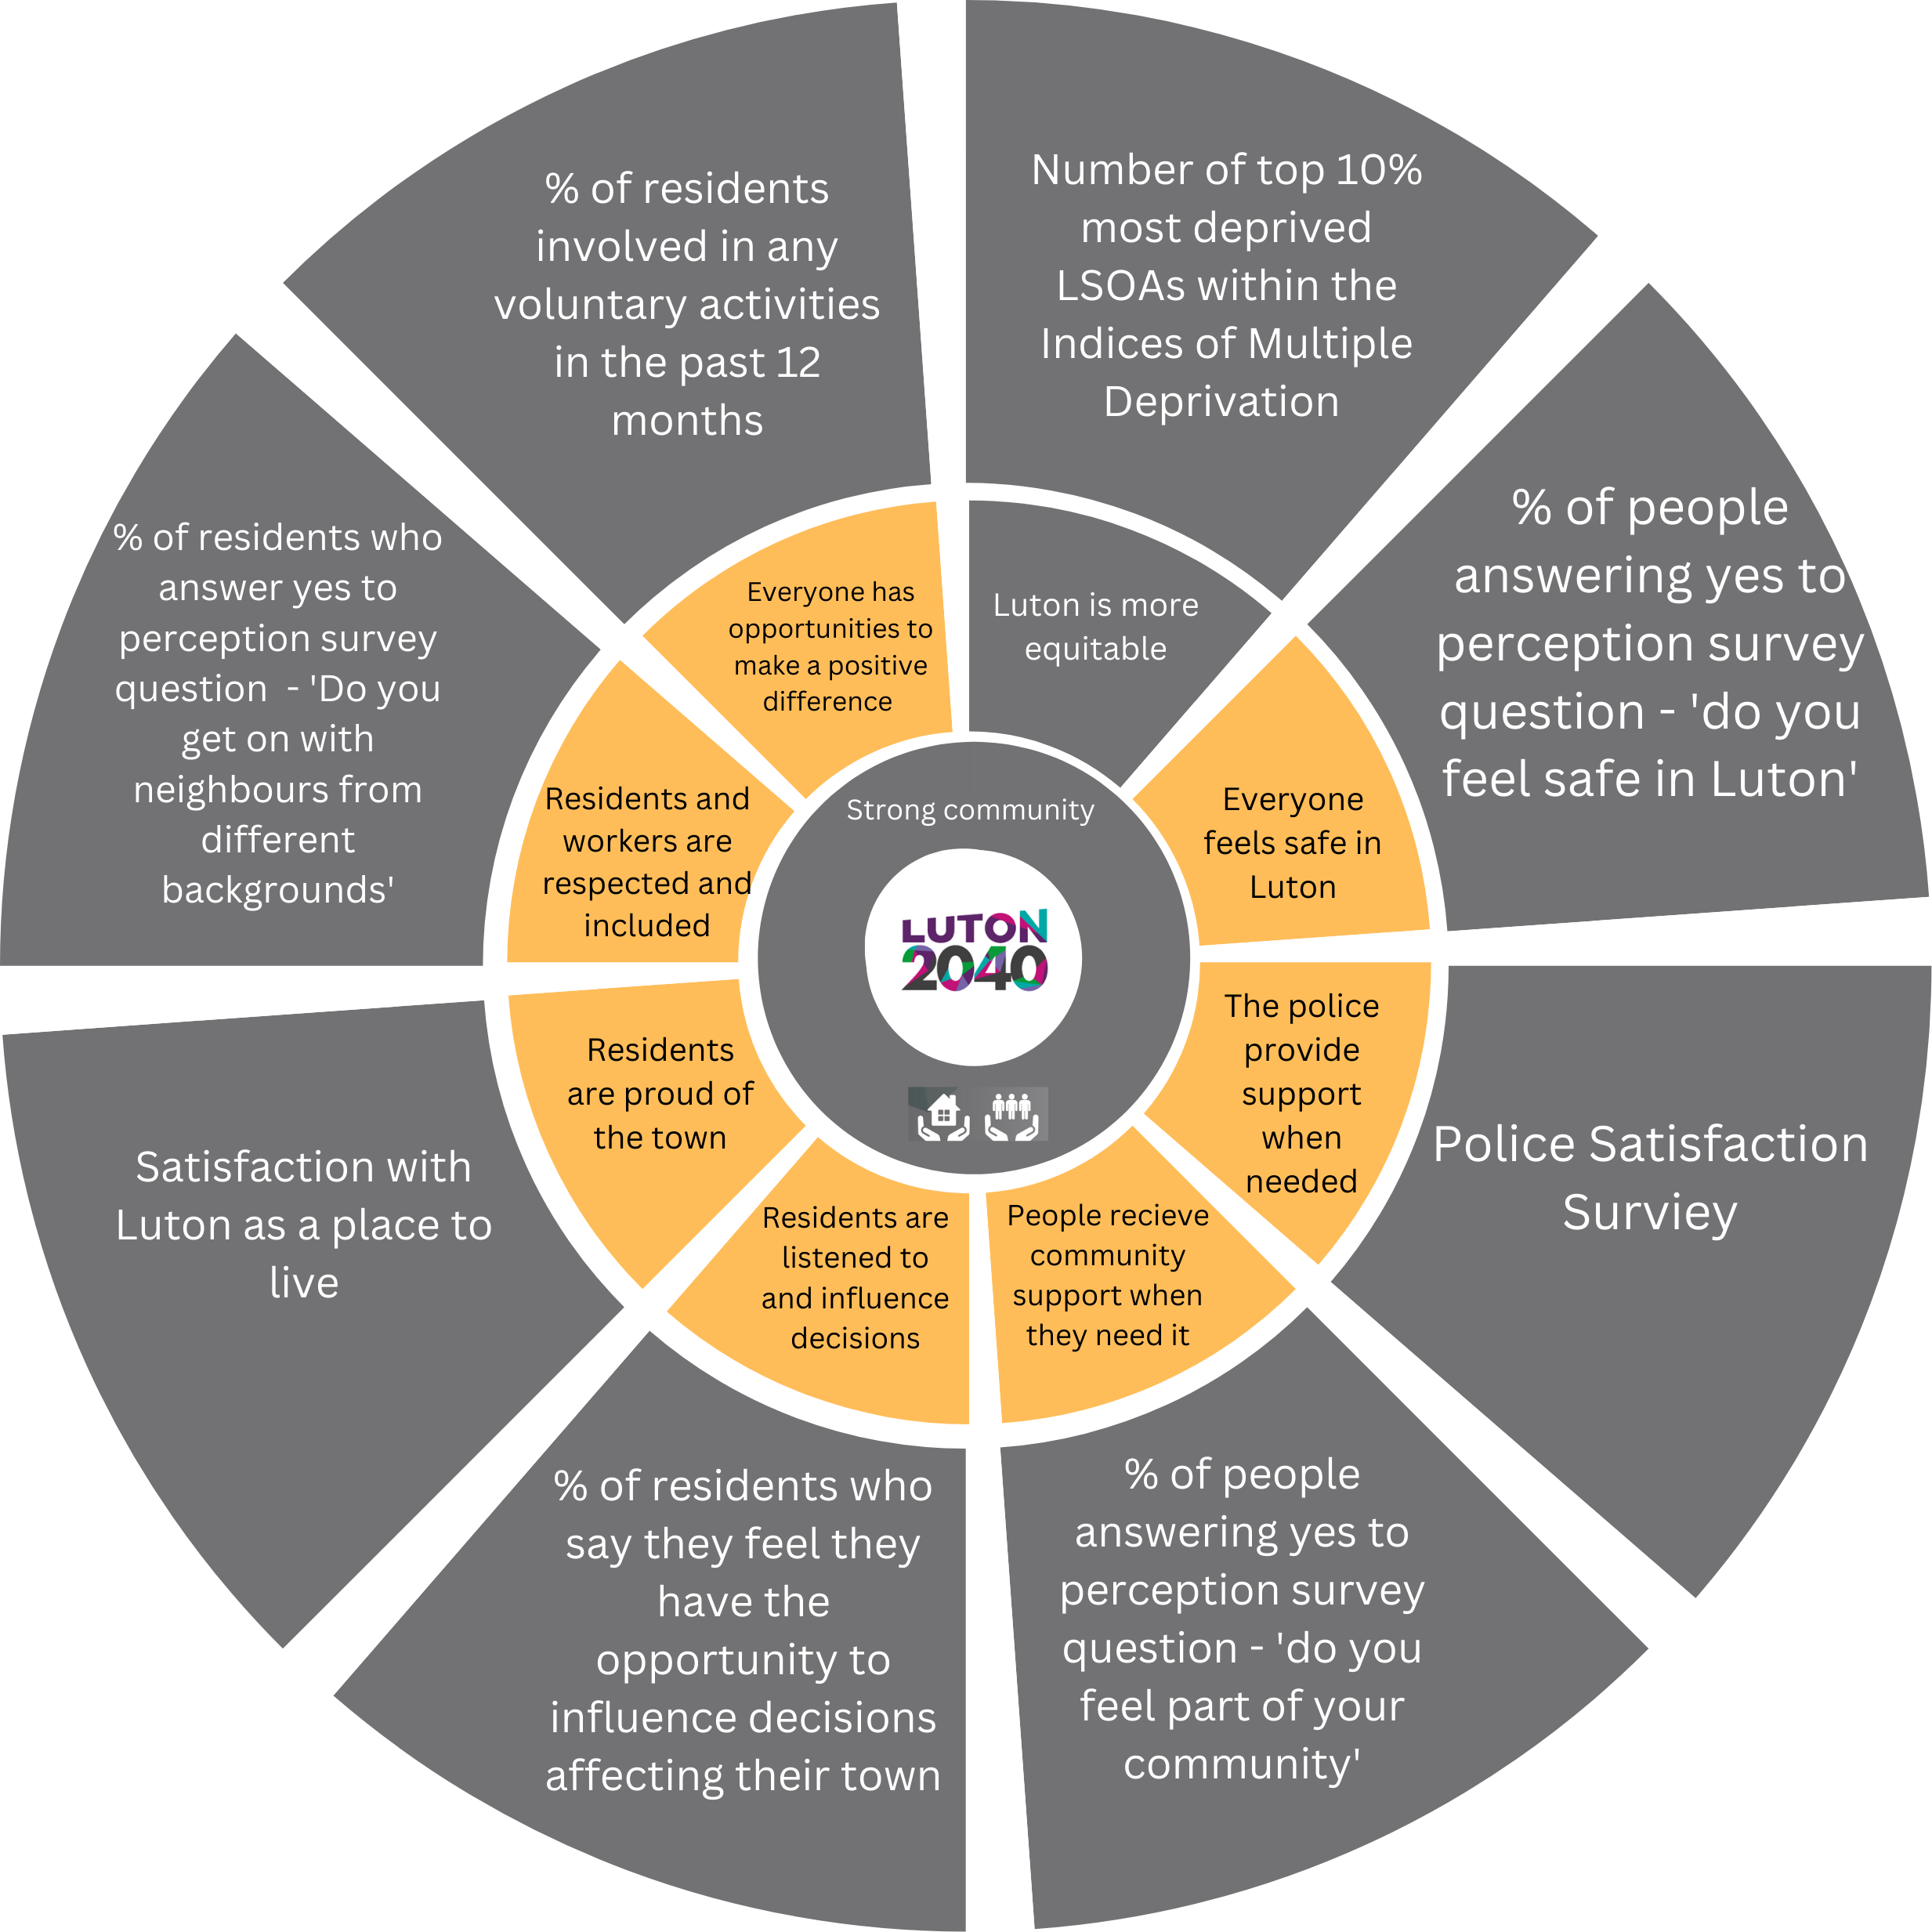
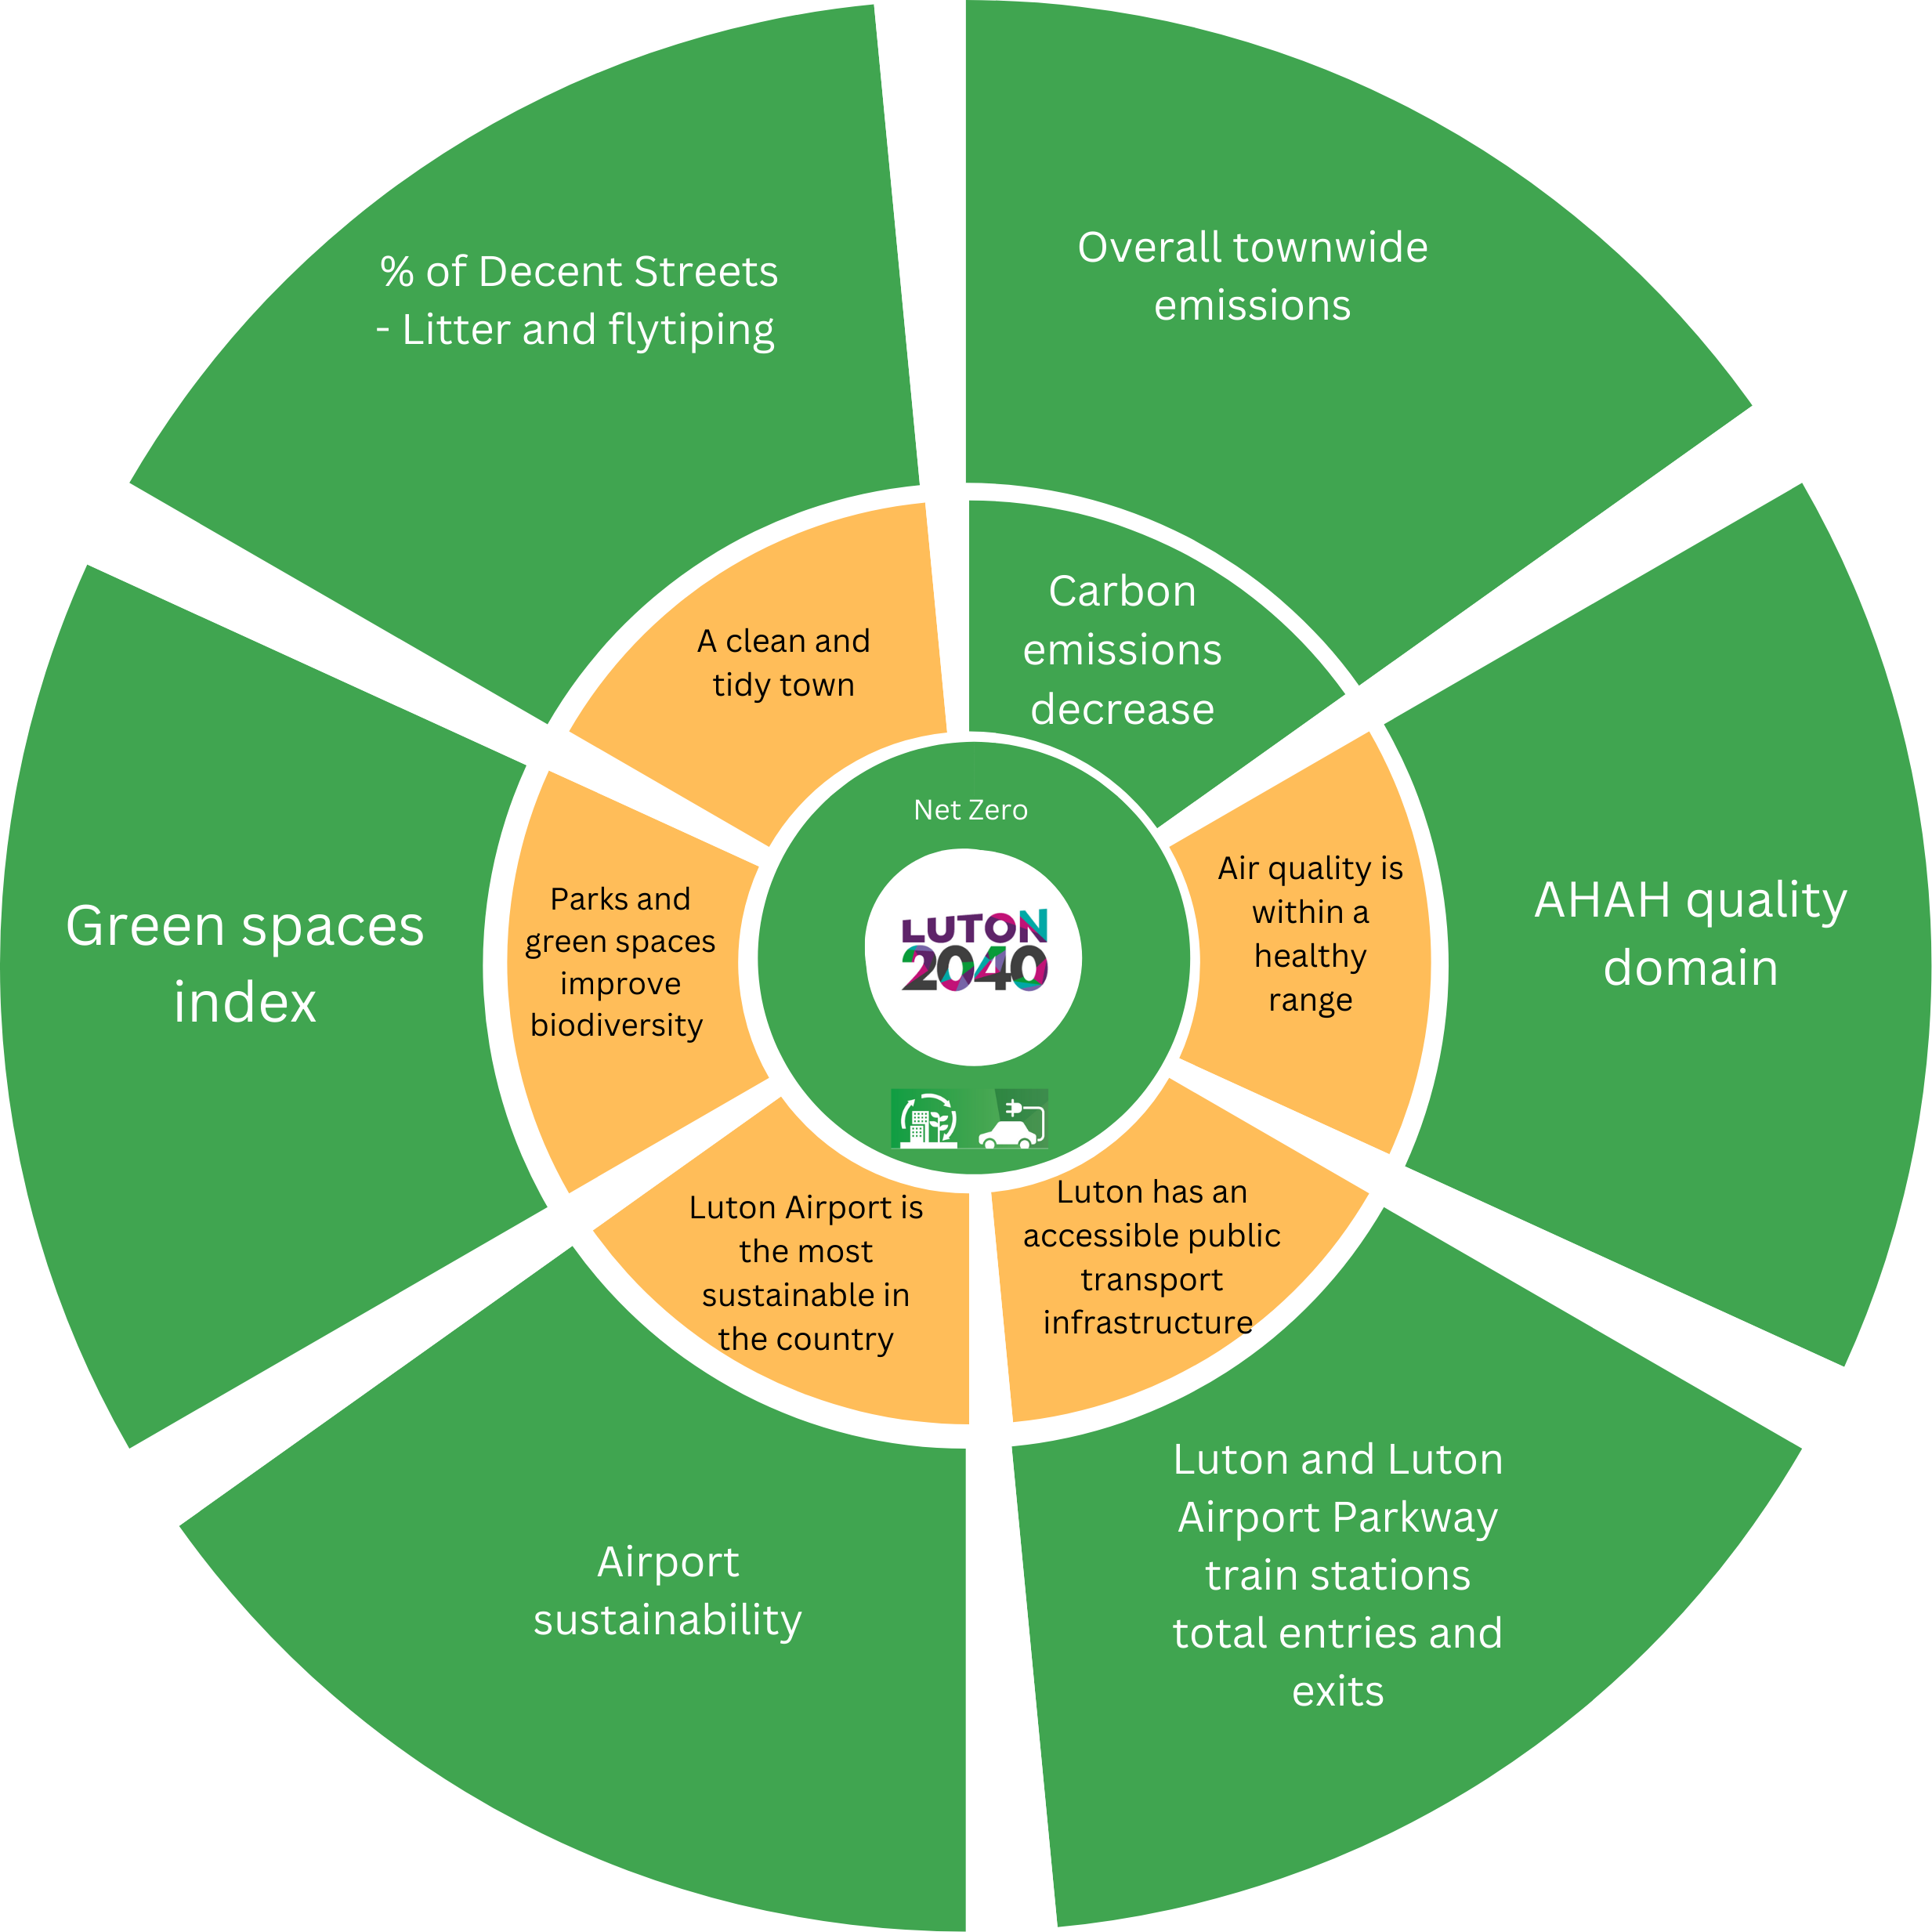
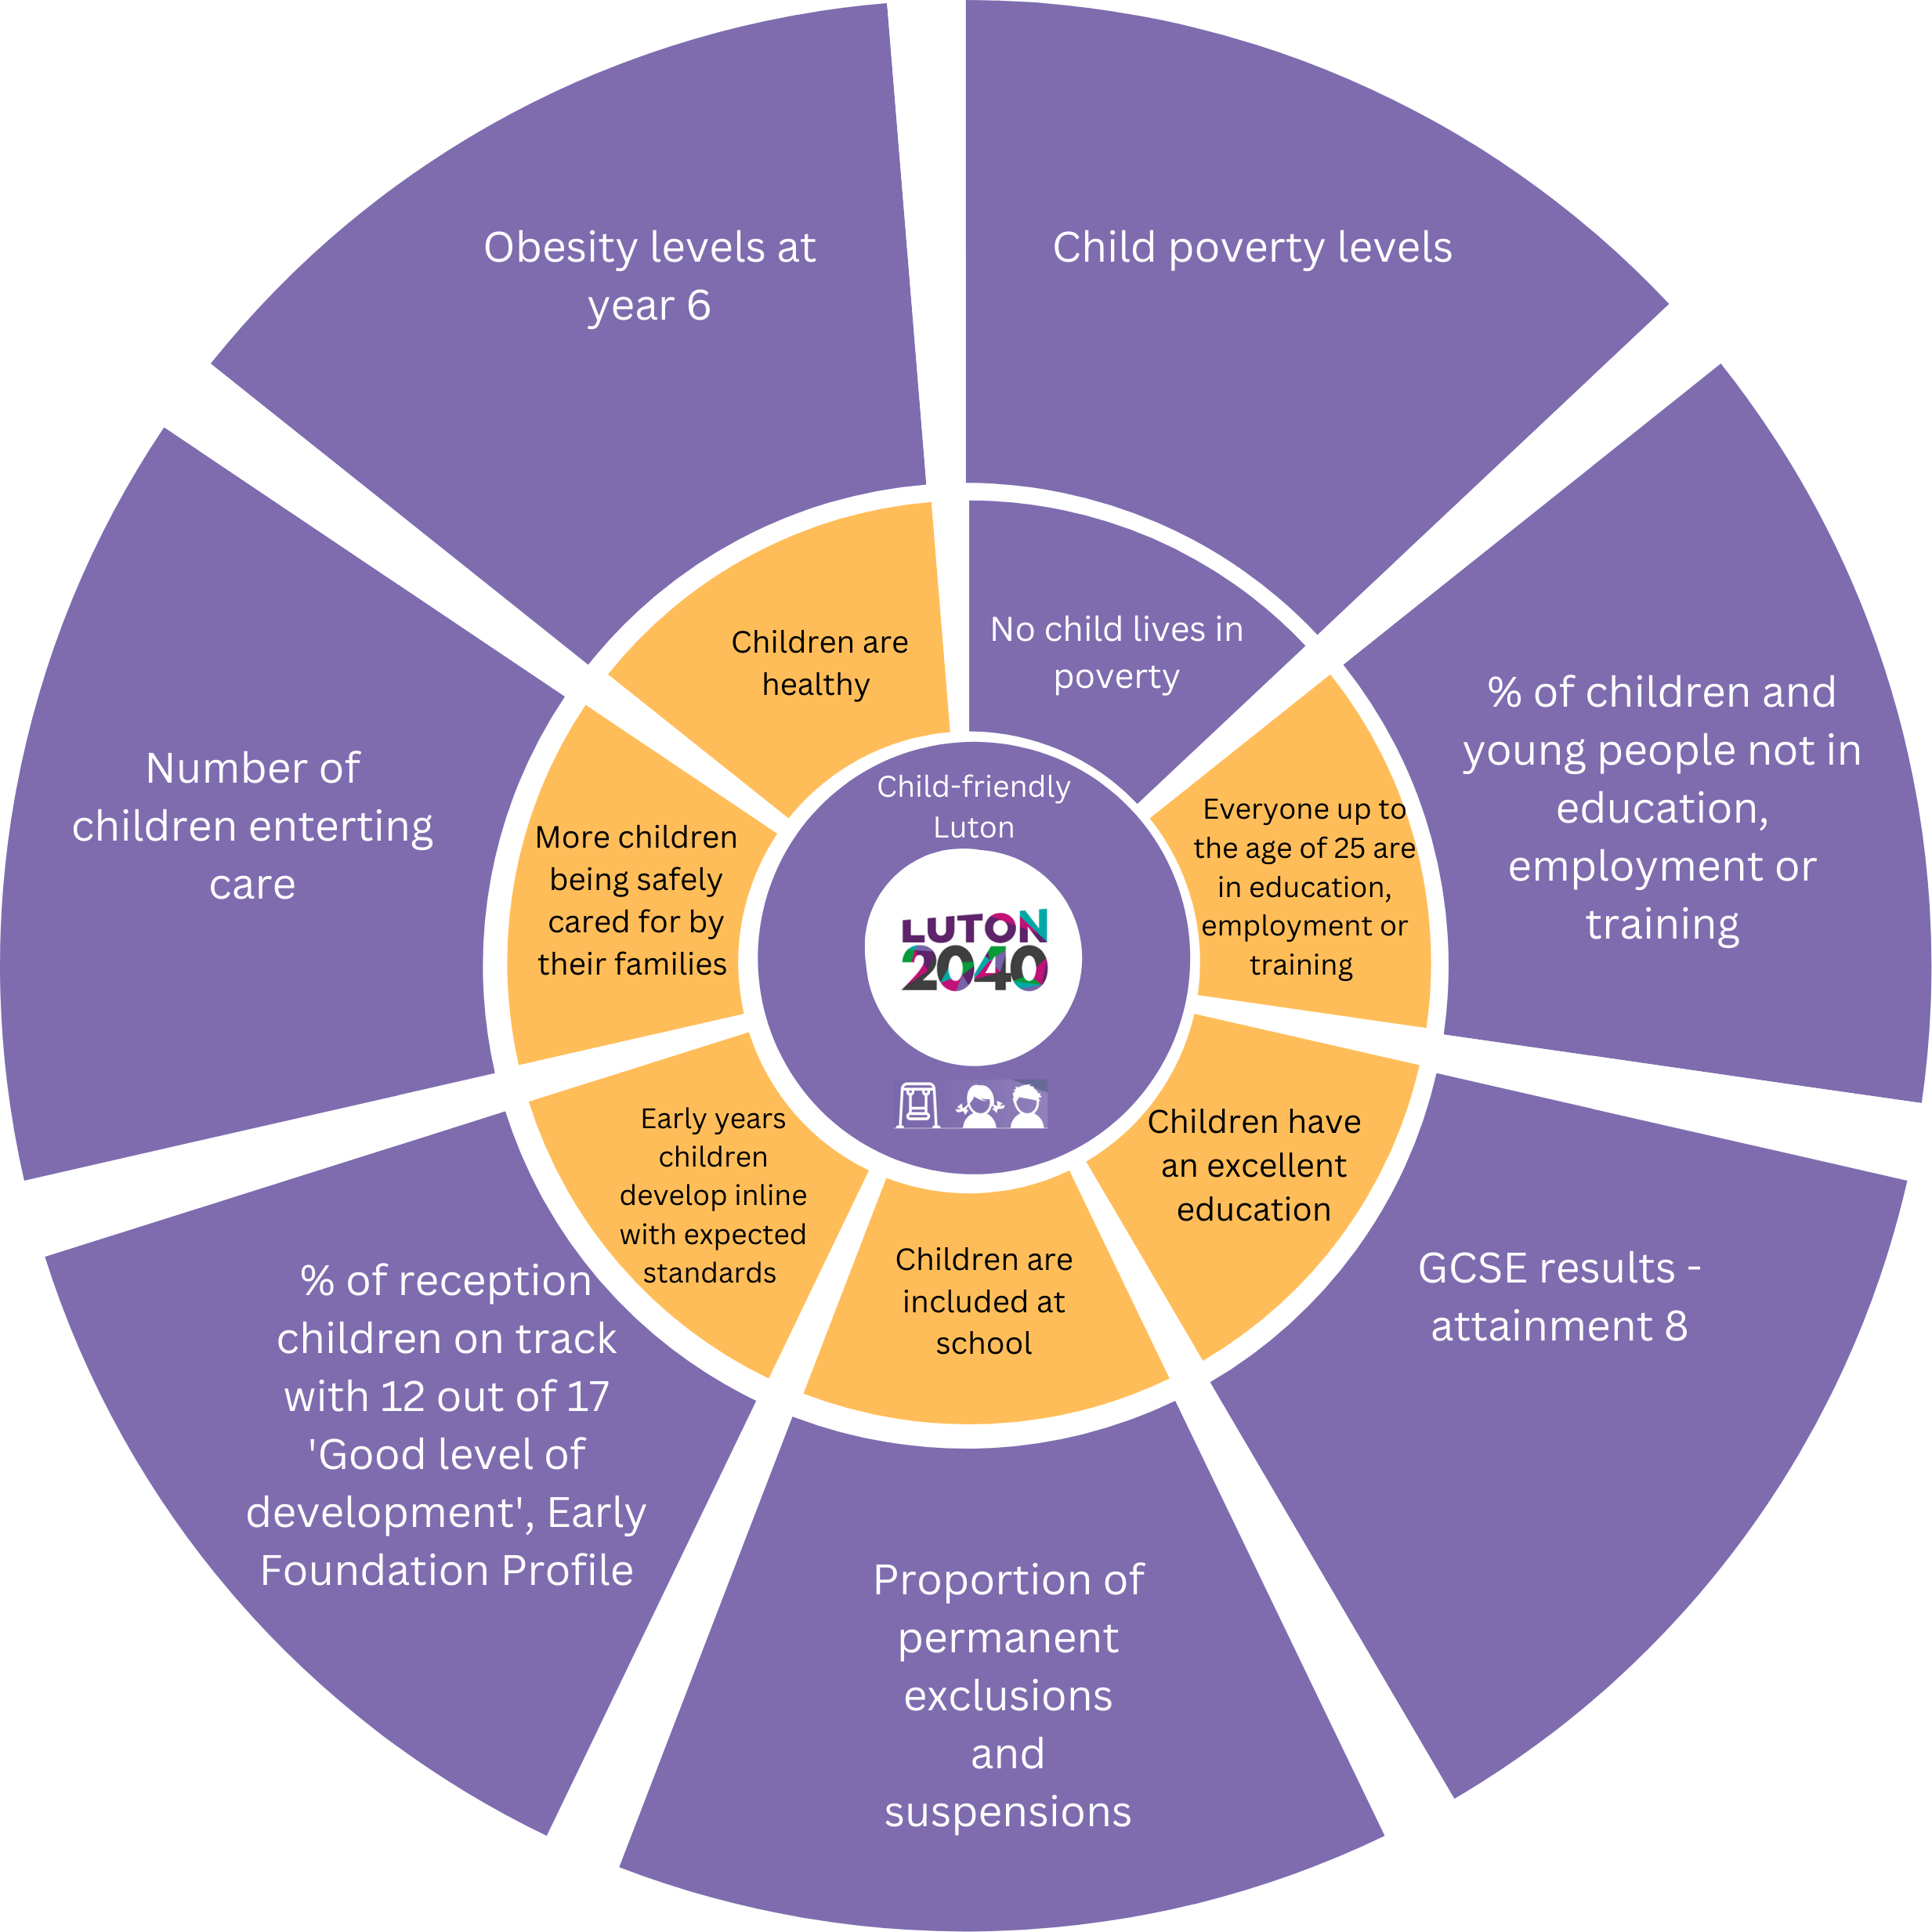


Slide 14
Governance
Groups
Fairness Taskforce
Inclusive Economy and…
Community Safety Partnership
Luton 2040 Partnership
Health Equity Town Partnership
Climate Action Group
Place Board
Health and Wellbeing Board
Population Wellbeing Delivery Group
Children’s Trust Board
Education and Learning Reset Partnership
Child Friendly Town Group

Slide 15
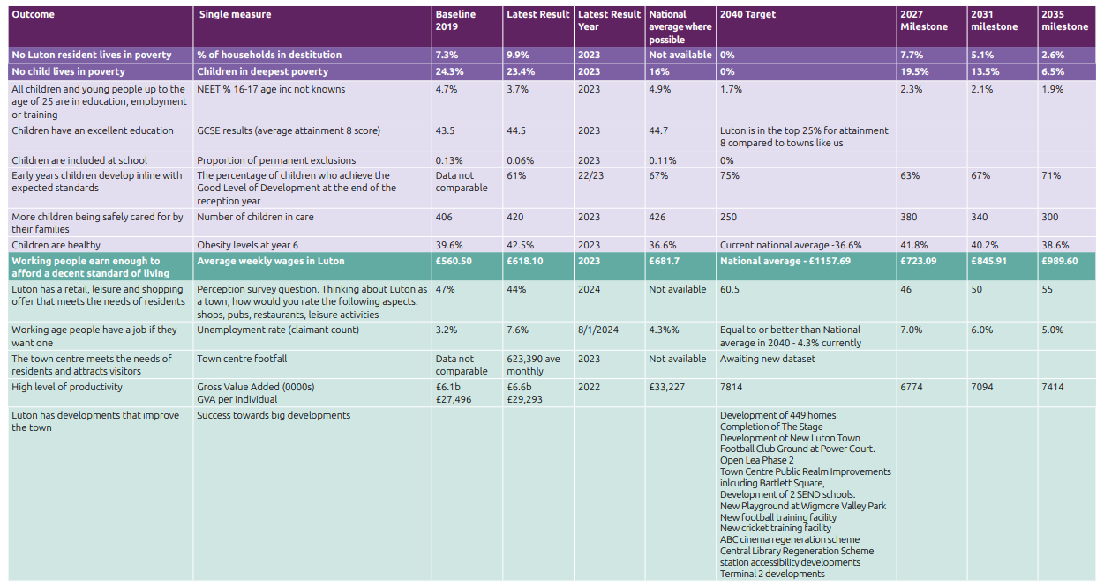
Road Map to 2040

Slide 16
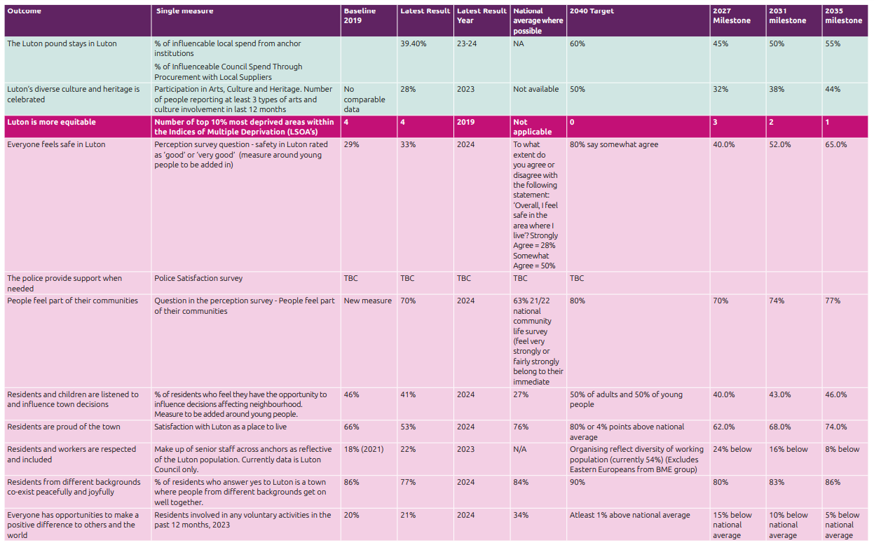
Road Map to 2040

Slide 17
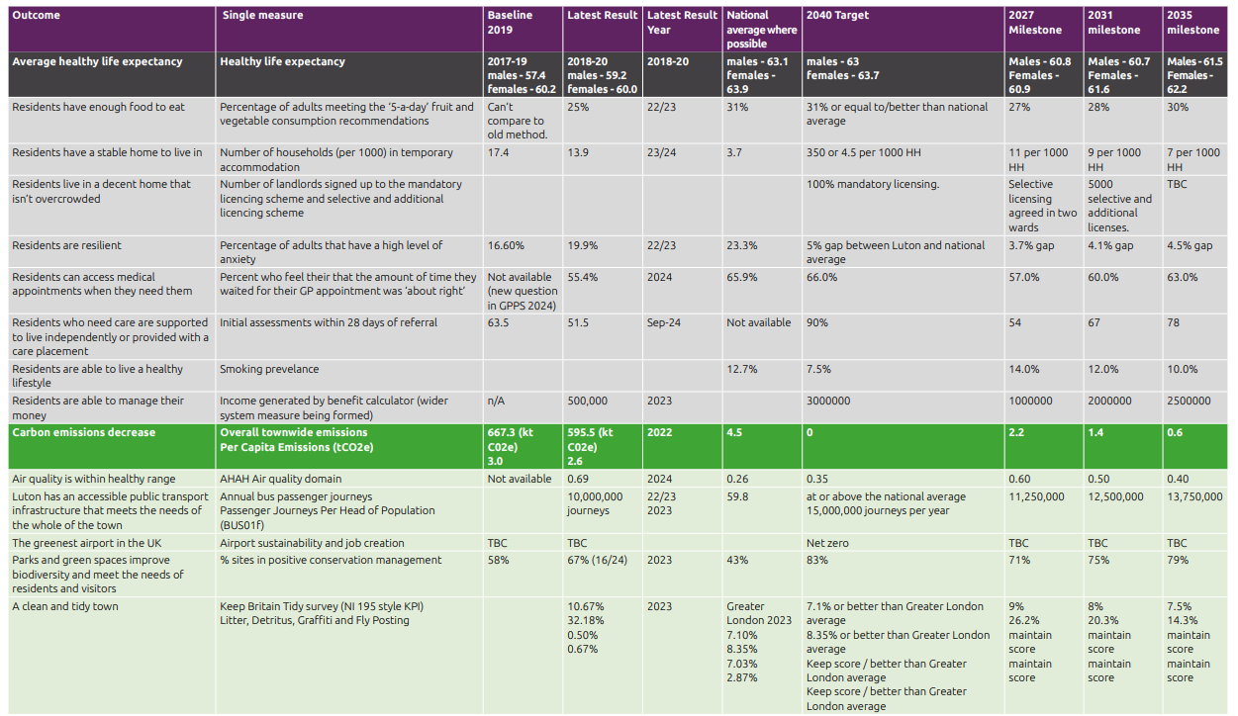
Road Map to 2040

Slide 18
Questions and comments

