Slide 1
Finance Update
Corporate Peer Challenge
22nd January 2025

Slide 2
Update of Audit Position 2018/19 to 2023/24
Audit for 2018/19 to 2022/23 have been completed and accounts signed.
Under the backstop regulations auditors have disclaimed their opinion as they did not perform the audit for the years 2019/20 to 2022/23.
Auditors issued a PIR raising issues regarding capacity and capability in finance team. Also accounting treatment of DCO costs and infrastructure assets. This was discussed at full Council and we agreed with some of the recommendations.
VFM report areas of concerns in 2022/23 e.g. financial sustainability and concerns about capacity and capability in finance team
Audit 2023/24 progressing well. Accounts to be presented to audit committee on 25 February 2025.
Auditors will issue their vfm and audit results report which will be presented to the Audit Committee in February
We have had to employ additional staff to deal with issues mainly technical such as collection fund and key financial controls identified and now most have been resolved.
Auditors will disclaim based on the backstop regulations as prior years accounts have been disclaimed.
We have started 2024/25 audit process which will be subject to a full Audit.
Auditors have identified issues with capacity and capability as there is at present reliance on interim staff.
The finance team is not structured to cope with the demand from services and the challenge faced by the council and this is being reviewed as part of CIPFA review.

Slide 3

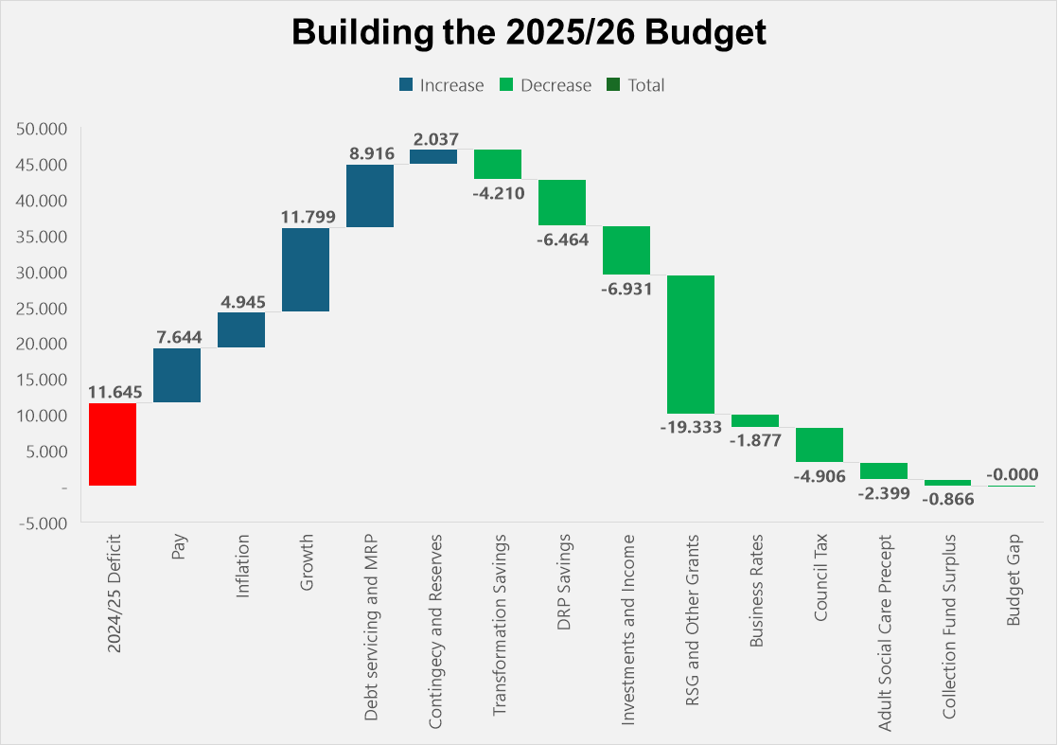

2025/26 How Budget Gap has been balanced
including delivery of DRP and transformation Savings

Slide 4
