Slide 1
The effectiveness of financial management at Luton Council - a review and analysis of culture, skills and processes across the organisation
Corporate Peer Challenge update
22nd January 2025

Slide 2
Thematic approach linked to the CPC recommendations
Capacity, capability and succession planning within the finance function (FIN 16, 17, 18)
Skills development for Members and non-finance senior officers (FIN 15, 20)
The effectiveness in theory and practice of Financial Regulations, in particular, the Scheme of Devolved Financial Management in promoting a sensible and proportionate balance between central regulation and devolution of authority (FIN 15, 19, 20)
The role of the MTFP [Medium Term Financial Plan] (including the Capital Programme) in strategic financial planning (FIN 21, 22, 26, 27)
The effectiveness of financial monitoring (FIN 23, 24)

Slide 3
Scope of the review
CIPFA has been appointed to carry out the following activities:
An initial meeting with the project sponsor to agree the planned work, progress updates and deliverables
Initial one-to-one Teams based interviews with the s.151 officer and senior management team
A review of core documents, including a comparison of existing financial regulations and guidance against best practice models
One-to-one Teams based interviews with a selection of directors, cost centre managers, finance staff, internal audit and Members
A self-completion survey of other cost centre managers and finance staff
An assessment against the CIPFA FM Code to identify strengths and areas for improvement
An informal feedback session of emerging findings from the review and any changes required to the financial regulations with the s151 Officer and MO
Preparing a written report that sets out:
  The recommended changes to existing financial regulations
  Identification of the strengths and areas for improvement in financial management practice (both within finance and across the directorates within the Council)
  A road map that sets out how the changes should be implemented
Presentation of the final report to the senior management team and the Executive

Slide 4
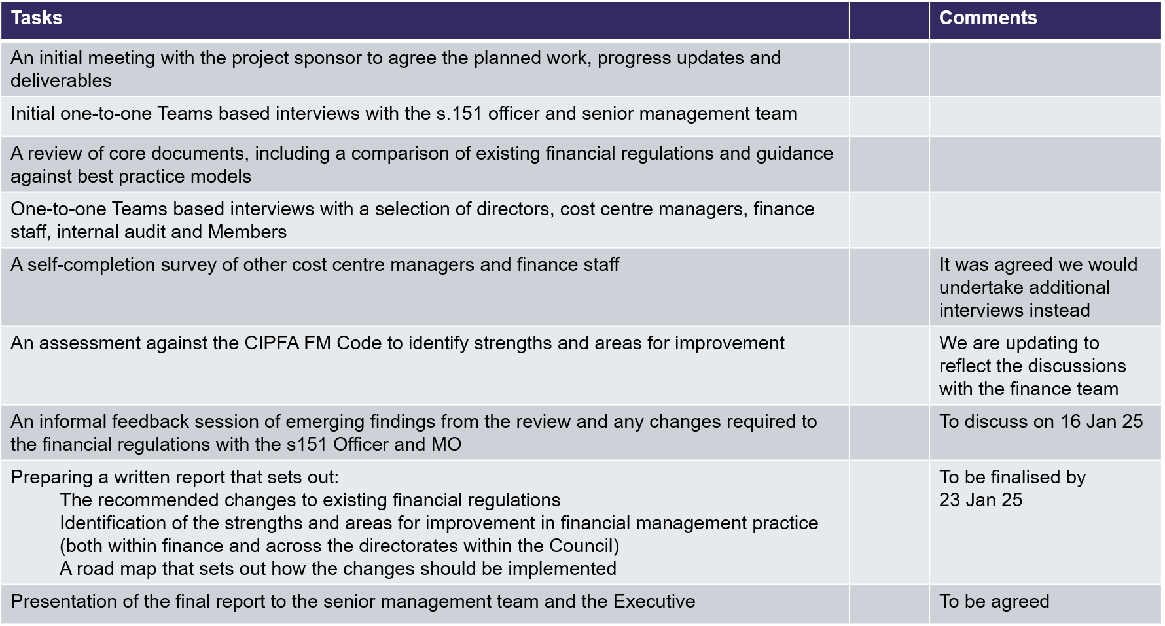
Progress of the review
n/a

